Slide 1
Tips on successful online learning.

Slide 2
Set Alarms
Why?
You can track your time, be more focused and reward yourself when you finish.
How?
Set your phone timer for 30 minutes, then give yourself 5-10 minutes of free time!

Slide 3
Create an Organized Study Space
Why?
A study space will help you focus and create less distractions.
Make sure laptop is charged at all times .
How?
Find somewhere quiet.
Find a desk or table.
Organize it with your computer and other supplies.

Slide 4
Stick to a Routine
Why?
You'll have more time and be less tired.
How?
Get up on time..
Get dressed.
Have something to eat.

Slide 5
Communicate with Teachers
Why?
You need to know what to do (teachers are there to help)
How?
Check online school platforms daily. (emails, zoom, teams, PAWS) You will find these icons on your dashboard.

Slide 6
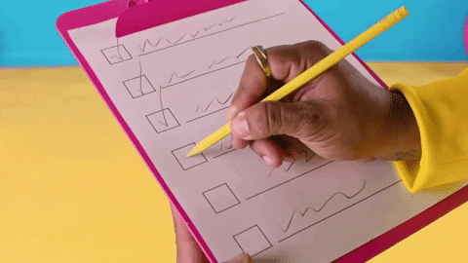
Create Daily Checklist
Why?
It will keep you on track, you can measure your work and the things you need to accomplish.
How?
Use your phone notes
Write it down
Reward yourself for your accomplishments..

Slide 7
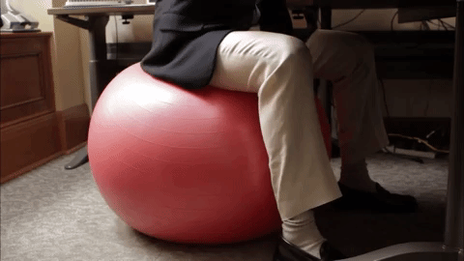
Don't sit down all day
Why?
It is bad for your posture and legs.
You can become sore and stiff, when may lead to bad health.
How?
Create a standing desk.
Sit on an exercise ball.
Walk around the house while working.

Slide 8
Eat healthier
Why?
Healthy eating helps with better brain function and you can learn better.
How?
Have a healthy breakfast.
Eat a small meal before evening classes.
Eat more fruit and vegetables.

Slide 9
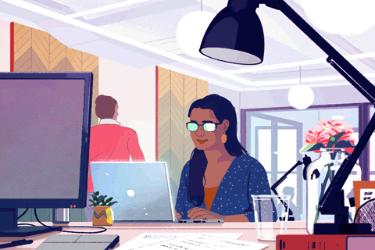
Reduce the screen time
Why?
You will feel better, your eyes will get rest and you will sleep better.
How?
Don't go on your phone or watch tv when taking a break or before bed.
Do crossword puzzles.
Draw or Paint.
Listen to music .

Slide 10
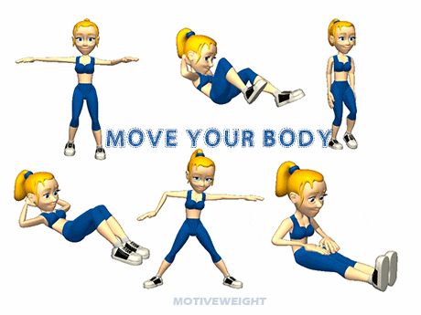
Get Moving and go outside
Why?
You won't feel so couped up you'll get the essential nutrients and exercise needed.
How?
Take breaks outside
Go for a walk

Slide 11
Don't work on the weekend
Why?
You deserve a break.
How?
Spend time with family.
Watch Movies.
GET REST!

