Slide 1
National Cybersecurity Awareness Month 2020
CYBERSECURITY AWARENESS MONTH 2021

Slide 2
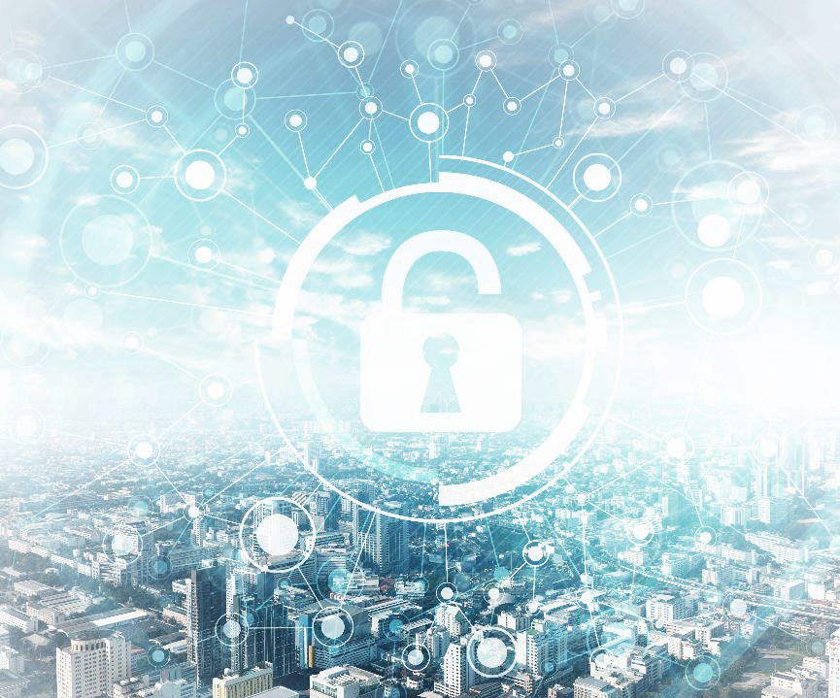
What Is Cybersecurity Awareness Month?
Cybersecurity Awareness Month raises awareness about the importance of cybersecurity across our Nation.
Notes:
Held every October for 18 years now, Cybersecurity Awareness Month is a collaborative effort between government and industry, reaching from the White House to the individual to raise awareness about the importance of cybersecurity, seeking to ensure that everyone has the resources they need to be safer and more secure online. Over these past 18 years, our lives have moved more and more into the virtual realm, and as we prepare for the upcoming holidays, October is the ideal time for people to learn about their cyber presence and the role cybersecurity plays in keeping them, their friends and family, and our nation safe and secure.
The Cybersecurity and Infrastructure Security Agency (CISA) leads Cybersecurity Awareness Month alongside private sector partner, the National Cyber Security Alliance (NCSA). They work closely with partners at all levels to help enhance our Nation’s cybersecurity posture through engagement with their staff, communities, and the public in general. Cybersecurity Awareness Month seeks to showcase the importance of cybersecurity awareness year-round to create a safer, more secure, and resilient cyber world.

Slide 3
Cybersecurity “So What?”
Did You Know?
Antivirus software is available for mobile devices, which are an easy, common target for hackers and other bad actors.
Cybersecurity Common Sense | Being safe online isn’t so different from being safe in the physical world! Keep Calm and Trust Your Gut!
Commonly Used Terms | Bad Actor Hacker Cyber Attack
3
Notes:
Cyber Common Sense:
Cybersecurity may seem frightening and intimidating at first glance, but most cybersecurity best practices are just common sense! You use cyber principles in your everyday life without realizing it—from delegating tasks to friends or coworkers to building toy castles with your kids! And the best way to apply those skills to ensure your cyber safety is to learn what kinds of attacks you are vulnerable to, and to learn the easiest way to defeat them.
Commonly Used Terms:
The terminology surrounding cybersecurity may be confusing at first, so let’s go over a few of the words we’ll be using throughout this activity.
A “bad actor” is anyone looking to make trouble for you and your computer system. This can include a variety of cybercriminals—hackers, social engineers, and even shoulder surfers!
Hackers use computers and other digital devices to gain unauthorized access to information or damage computer systems. Sometimes, hackers have impressive computer skills, but expert knowledge of programming isn’t always necessary for a successful hack.
Any attempt by hackers or bad actors to gain unauthorized access to a digital computer system can constitute a cyber attack.
As always, if you come across a term or phrase about cyber or computer science – or even in your everyday life – that you don’t understand, look it up! Many cyber-specific terms are already part of the dictionary, and a simple online search can make a big difference in your understanding of the cyber ecosystem.

Slide 4
Do Your Part. #BeCyberSmart
Cybersecurity starts with YOU and is everyone’s responsibility.
There are currently an estimated
5.2 billion internet users or
63% of the world’s population.
4
Notes:
Cybersecurity isn’t just some far flung concept only used and needed by cyber professionals. Cybersecurity is the responsibility of every person who uses an internet-connected device.
Cybersecurity also isn’t just important to large businesses. Cybersecurity is essential to all businesses no matter their size and to all people.
Cybersecurity starts with YOU and is everyone’s responsibility.
There are currently an estimated 5.8 billion internet users worldwide. That’s over 63% of the world's population! This number will continue to grow, making cybersecurity more important than ever. (source: https://internetworldstats.com/stats.htm pulled 7/8/2021).

Slide 5
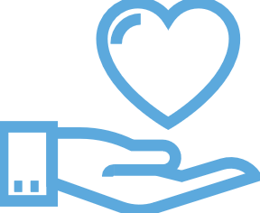
Cybercrime
What is it?
Cybercrime is any crime which is committed electronically.
This can include…
Theft
Fraud
Sometimes even murder
Why should you care?
Crime is a danger offline and on!
Cyber self-defense basics can go a long way to keeping you and your data out of the hands of bad actors.
Examples
Identity theft Child sexual abuse materials Financial theft Intellectual property violations Malware Malicious social engineering
5
Notes:
What is it? :
We don’t often consider whether or not the people we interact with online might be breaking the law. But legal wrongdoing is just as prevalent on the internet as it is in the physical world. Cybercrime is any crime, including, but not limited to, theft, fraud, and even sometimes murder, which is committed electronically.
Why should you care? :
We all want a safer world to live in, and it’s clear, now more than ever, that computers and other internet-connected devices are part of that world. Being safe on the computer is often very similar to being safe in your daily offline routine. You wouldn’t leave your car unlocked in the middle of a crowded city – so why not apply those same safety principles to your online life?

Slide 6
Malware
What is it?
Any software intended to…
Damage
Disable
Or give someone unauthorized access to your computer or other internet-connected device
Why should you care?
Most cybercrime begins with some sort of malware. You, your family, and your personal information is almost certainly at risk if malware finds its way onto your computer or devices.
Examples
Ransomware Adware Botnets Rootkits Spyware Viruses Worms
6
Notes:
What is it? :
Malware, short for “malicious software,” is software intended to damage, disable, or give someone unauthorized access to your computer or other internet-connected device. This includes adware, botnets, ransomware, rootkits, spyware, viruses, worms, and numerous others.
Why should you care? :
Most cybercrime begins with some sort of malware. You, your family, and your personal information is almost certainly at risk if malware finds its way onto your computer or devices.

Slide 7
ransomware
What is it?
Malware designed to make data or hardware inaccessible to the victim until a ransom is paid.
Why should you care?
Often downloaded as malicious email links
Damage to both financial stability and reputation
No guarantee that you will get your data back, even if you pay
Often used as a decoy for other malicious activity
Examples
Cryptolocker Winlock Cryptowall Reveton Bad rabbit Crysis Wannacry
7
Notes:
What is it? :
It’s easy to forget sometimes how valuable the information we store on our computers and devices really is to us. Family photos, financial information, address books, homework assignments—so much of our lives is stored digitally! Ransomware is a type of malware in which the attacker encrypts the victim’s data to make it as inaccessible as possible, often by locking a person completely out of their computer. Then the hacker demands a ransom to release or unencrypt that information.
Why should you care? :
The fees extorted by cybercriminals through ransomware can be extreme or prohibitive—not to mention that there’s no guarantee that your data will actually be returned to you after you pay! Luckily, there’s a simple way to make yourself and your data resistant to ransomware attacks. In addition to keeping your software and antivirus programs up to date, regularly back up your system on the cloud or on an external hard drive. That way, you always have a spare copy of the information that’s most important to you.

Slide 8
bots
What is it?
Bots are a type of program used for automating tasks on the internet.
Why should you care?
Malicious bots can:
Gather passwords
Log keystrokes
Obtain financial information
Hijack social media accounts
Use your email to send spam
Open back doors on the infected device
Did You Know?
Not all bots are bad. When you use a search engine, these results are made possible by the help of bots “crawling” the internet and indexing content. Chatbots like Siri and Alexa are another common type of “good” bot.
8
Notes:
What is it? :
Cyber attacks don’t always have to come from the internet, and some malware can hide easily on some of the data storage devices we trust and use on a daily basis. Physical cyber attacks use hardware, external storage devices, or other physical attack types of attacks to infect, damage, or otherwise compromise digital systems. The attack can hitch a ride on USB storage devices or flash drives, CDs, hard copies of video games, and Internet of Things devices such as smartphones, smart watches, and even signal devices such as key fobs.
Why should you care? :
These kinds of attacks are frighteningly versatile, very difficult to identify and detect, and painfully difficult – sometimes close to impossible – to remove. Always try to keep track of where your storage devices have been, and don’t plug “lost-and-found” USB drives into your computer. Keep your personal and workplace data storage and other devices separate to avoid transferring malware from one system to another – just like washing your hands to prevent the flu from spreading!

Slide 9
Physical cyber attacks
What is it?
Physical cyber attacks use hardware, external storage devices, or other physical attack vectors to infect, damage, or otherwise compromise digital systems. This can include…
USB storage devices
CD/DVD
Internet of Things (IoT)
Why should you care?
Easy to overlook
Difficult to identify and detect
Extremely difficult to remove
Can do anything from installing ransomware, to sending copies of or modifying information systems, to dismantling networks
Did You Know?
Anything connected to the internet is potentially vulnerable, from e-scooters to laptops to cargo ships.
9
Notes:
What is it? :
Cyber attacks don’t always have to come from the internet, and some malware can hide easily on some of the data storage devices we trust and use on a daily basis. Physical cyber attacks use hardware, external storage devices, or other physical attack types of attacks to infect, damage, or otherwise compromise digital systems. The attack can hitch a ride on USB storage devices or flash drives, CDs, hard copies of video games, and Internet of Things devices such as smartphones, smart watches, and even signal devices such as key fobs.
Why should you care? :
These kinds of attacks are frighteningly versatile, very difficult to identify and detect, and painfully difficult – sometimes close to impossible – to remove. Always try to keep track of where your storage devices have been, and don’t plug “lost-and-found” USB drives into your computer. Keep your personal and workplace data storage and other devices separate to avoid transferring malware from one system to another – just like washing your hands to prevent the flu from spreading!

Slide 10
Social engineering
What is it?
Cybercriminals can take advantage of you by using information commonly available through…
Social media platforms
Location sharing
In-person conversations
Why should you care?
Your privacy isn’t just a luxury – it’s a security measure
Attacks can be successful with little to no programming knowledge or ability
Technological security measures can only protect you so much – you are your best defense
Examples
Phishing Pretexting Baiting Quid pro quo Tailgating Inside job Swatting
10
Notes:
What is it? :
Sometimes bad actors don’t need computers to gain access to your information. Social Engineering is when bad actors gather commonly available information about you and things you care about in order to trick you into revealing information or giving unauthorized access to information systems. Social Engineering attacks can be quite sophisticated, and are not always easy to recognize. This includes attacks such as Phishing, Swatting, and more.
Why should you care? :
Social engineering attacks don’t require super powered programming skills to be successful. The information you post on social media and other sharing platforms may make you especially vulnerable to this attack vector, and it may be difficult to tell when you are being targeted.

Slide 11
Phishing
What is it?
Fake messages from a seemingly trusted or reputable source designed to convince you to…
Reveal information
Give unauthorized access to a system
Click on a link
Commit to a financial transaction
Why should you care?
Extremely common
Can have severe consequences
Devil‘s in the details
Examples
Emails Text messages Phone calls Social media messages and posts Suspicious hyperlinks
11
Notes:
What is it? :
Phishing is a kind of Social Engineering attack in which a bad actor poses as a trusted or reputable source and sends fraudulent digital messages, such as emails, with the intent of manipulating individuals into revealing personal or protected information, or with the intent of gaining unauthorized access to a system through a download or link.
Why should you care? :
Phishing attacks are some of the most common—and most commonly successful—types of attacks. Learning how to recognize fraudulent messages by paying close attention to detail and never clicking on embedded hyperlinks, as well as remembering to report phishing attempts when you are targeted, are the best ways to defeat this kind of cyber attack. When clicking on links ensure that URLs begin with “https.” The “s” indicates encryption is enabled to protect users’ information.

Slide 12
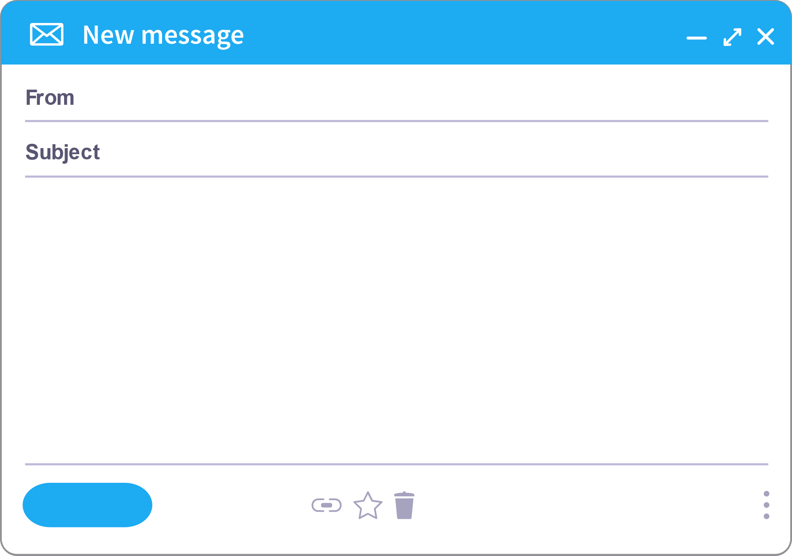
Would This Email Fool You?
Legitimate-Looking-Source@notquiteyourworkemail.com
Ugent IT Update: Software Vulnerability
Software Update
Good afternoon Tom,
A vulneribility has been identified in “Big Name Software” that allows an attacker to record calls and videos from your computer without your knowldge. Please install the attacked update by the end of the day or your workstation will be locked.
We have also created app for all employees to determan if they been affected by this vulnerability. Click here to run the app.
Sincerely, BossMann Your Company IT Department
www.fakewebsite.com/gotcha.exe
Click or tap to follow link.
REPLY
12
Notes:
Instructions:
Take a look at this sample Phishing email. Would this email fool you?
Phishing Email Text :
Good afternoon Tom,
A vulneribility has been identified in “Big Name Software” that allows an attacker to record calls and videos from your computer without your knowldge. Please install the attacked update by the end of the day or your workstation will be locked.
We have also created app for all employees to determan if they been affected by this vulnerability. Click here to run the app.
Sincerely, BossMann Your Company IT Department
Questions for Discussion :
What kind of information could the bad actor have used to target Tom?
What are the telltale signs that the email is from a hacker, and not a legitimate email from the IT Department?
Talking Points:
Email
Tone and sense of urgency
Embedded Hyperlink
Workplace
Position of Authority, Boss’s name
Tone
Misspelling and grammar issues
Conclusion:
Not all phishing attacks are as obvious as this, showing the need to learn the signs of these types of attacks and think before you click. Check that emails and links and legitimate. Verify all attachments come from a trusted source.

Slide 13
swatting
What is it?
An attack centered around location sharing in which bad actors call the police claiming the victim has committed a crime…
Bomb Threat
Armed Intruder
Violent Incident
Why should you care?
Physical and immediate consequences
Sometimes was intended merely as a prank
Arrest and serious injury can result
Reduce risk by sharing your location only with trusted individuals, and share vacation photos only after you’ve returned safely home
Examples
Your location is embedded as metadata in every picture you take with your phone. Turn location services off when you aren’t using them to make it more difficult for bad actors to view this information.
13
Notes:
What is it? :
Think Social Engineering is just for Phishing? Think again. Swatting is an attack centered around location sharing. Bad actors use your location to call the police, claiming that the victim has committed a serious crime. Sometimes, the intent behind these attacks are merely pranks – but the consequences are almost always severe.
Why should you care? :
Unlike many cyber-based attacks, Swatting has clear, physical, and immediate consequences. Imagine police raiding your home on a Swatting bomb threat tip! These attacks can easily result in injury and arrest, and sometimes even death to the victim. Your location is your business. Text or call friends the old fashioned way if you want to meet up, share vacation photos only after you’ve gotten safely home, and remember to turn off location services on your devices when you don’t need them.

Slide 14
Other avenues of attack
What is it?
Internet of everything
Any device connected to your network
Information collection
Remote access
Bluetooth
Open ports
Why should you care?
Your network can be used to attack someone else
Any device that stores information or is connected to the internet can be a vulnerability
Assume that you are vulnerable, and take measures to understand and mitigate risk
Don‘t be the “low-hanging fruit”
Examples
Smart devices Mobile phone Thermostat Vehicles Gaming consoles Printers Medical equipment Industrial systems
14
Notes:
What are your vulnerabilities? :
Any device that stores information or is connected to the internet can be a way for cyber criminals to gain access to your information systems – or, in some cases, use your devices to attack someone else. And with the advent of the Internet of Everything, you may have more of these kinds of devices around you than you think! Think about how much information is being gathered about you and your lifestyle and take the necessary precautions against that information being accessed unethically or misused.
Why should you care? :
The number of ways a bad actor can exploit you and your information is nearly limitless. But don’t let that get you down! Hackers and other cyber criminals will usually be most interested in the most vulnerable targets, which is good news for you. In the same way that you can’t entirely prevent a determined criminal from stealing something from you in the physical world, you likely also can’t be entirely impervious to malware and other hacks. However, making your devices and information as resistant as possible to cyber attacks can make you “not worth the effort” of trying to gain access to your information systems.

Slide 15
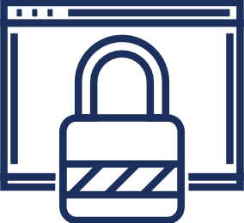
How Can You Better Protect Yourself Online?
Secure your networks.
Wireless routers are a way for cybercriminals to access online devices.
If You Connect It, Protect It.
One proven defense against intrusion is updating to the latest virus protection software.
Stay up to date.
Keep software updated to the latest versions and set security software to run regular scans.
Double your login protection.
Enable multi-factor authentication (MFA) to ensure that the only person who has access to your account is you.
15
Notes:
Secure your networks. Wireless routers are a way for cybercriminals to access online devices. Secure your Wi-Fi by changing the factory-set default router password and username.
If You Connect It, Protect It. One proven defense against intrusion is updating to the latest virus protection software. If you are putting something into your device, such as a USB or an external hard drive, make sure your device’s security software scans it for viruses and malware.
Stay up to date. Keep software updated to the latest versions, and set security software to run regular scans. Secure your web browsers and operating systems by turning on automatic updates so you do not have to think about it.
Double your login protection. Enable multi-factor authentication (MFA) to ensure that the only person who has access to your account is you. MFA is an extra layer of protection for your accounts, often in the form of a text, email, or automated phone call received after you’ve entered your password to confirm that you are in fact you and it’s not someone unauthorized trying to log into your account.

Slide 16
Password Tips
Use different passwords on different systems and accounts
Use the longest password allowed
Use a mix of uppercase and lowercase letter, numbers, and symbols
Reset your password every few months
Use a password manager
******
******
Did You Know?
Password or credential stuffing is a cyberattack that tries “stuffing” already comprised username and passwords from one site into another site in hopes that the user uses the same login information across platforms.
******
******
******
16
Notes:
One of the first lines of defense on keeping your information safe online is the use of a password. Some password tips are as follows:
Use different passwords on different systems and accounts. One of the leading causes of unauthorized access to accounts is the reuse of login credentials (see did you know box).
Use the longest password allowed. The longer and more complicated a password is, the harder it will be for someone to access your accounts.
Use a mix of uppercase and lowercase letter, numbers, and symbols. Everyone has seen that many sites require this, and it’s not there to inconvenience you, but to protect you and your data.
Reset your password every few months. It’s good to get into the habit of resetting your passwords regularly, especially when these password allow access to important personal information such as bank accounts or medical data. It is also especially important given that it takes most companies an average of six and a half months to notice that a data breach has happened. By the time a data breach is reported, a bad actor could have been using and/or selling your data for a considerable amount of time.
Use a password manager. The most secure way to store all of your unique passwords is by using a password manager. With just one master password, a computer can generate and retrieve passwords for every account that you have – protecting your online information, including credit card numbers and their three-digit Card Verification Value (CVV) codes, answers to security questions, and more.

Slide 17
Cybersecurity Awareness Month Theme
Theme:
Do Your Part. #BeCyberSmart.
17
Notes:
Since 1944, Smokey the Bear has said “only you can prevent forest fires.” In 1971, Woodsy the Owl started telling us to “give a hoot, don’t pollute.” And now Cybersecurity Awareness Month emphasizes the need to “Do Your Part. #BeCyberSmart.”
This year’s overarching theme is once again, “Do Your Part. #BeCyberSmart.” This evergreen theme encourages everyone to take proactive steps to enable lasting, positive cybersecurity behavior change at home, school, and at work. All internet-connected devices are potentially vulnerable, and as such, Cybersecurity Awareness Month emphasizes the critical need for individuals and organizations of all sizes in both public and private sectors to protect themselves against cyber threats.
Adequate protection from cyber threats is a critical challenge for individuals and organizations of all sizes in both the public and private sectors and serves as a constant reminder of the need to promote cybersecurity awareness across the Nation. Cybersecurity Awareness Month highlights the importance of empowering citizens, businesses, government, and schools to improve their cybersecurity preparedness. It reminds us that being more secure online is a shared responsibility and creating a safer cyber environment requires engagement from the entire Nation.

