Slide 1
OER 101
Ryan Korstange, Elizabeth Spica, and Rachel Fleming

Slide 2
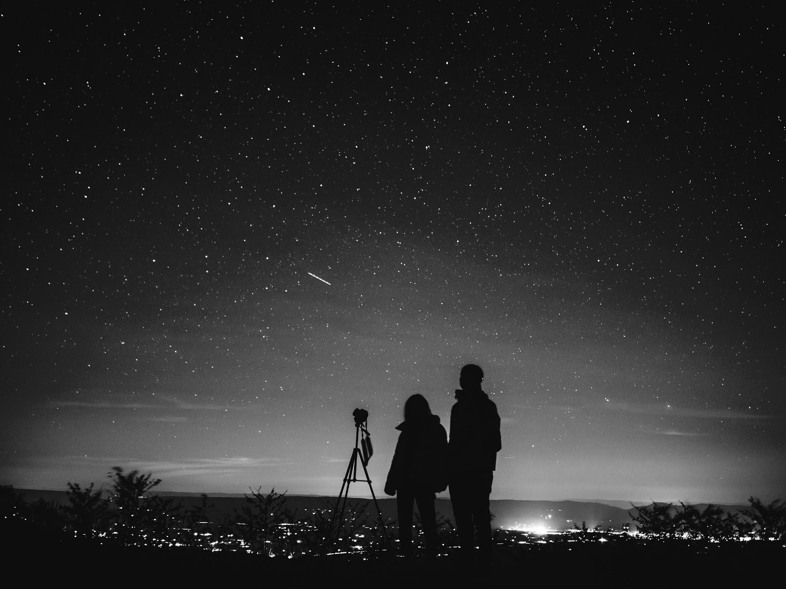
Zooming Out: Why OER?

Slide 3
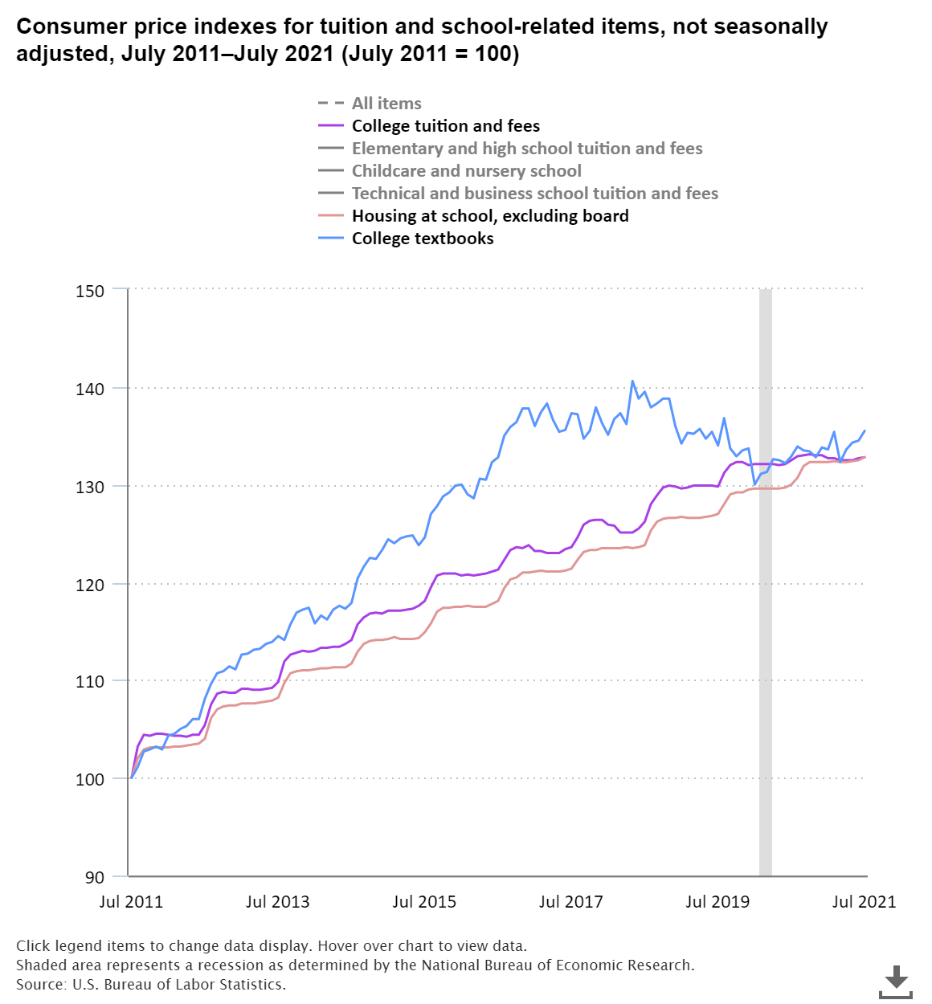
Consumer price Indexes for tuition and school related items July 2011-July 2021
Source: US Bureau of Labor Statistics
Notes:
*Not seasonally adjusted.

Slide 4
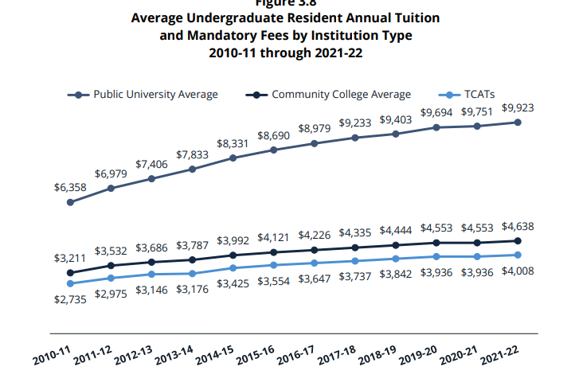
Source: Tennessee Higher Education Factbook 2021-22

Slide 5
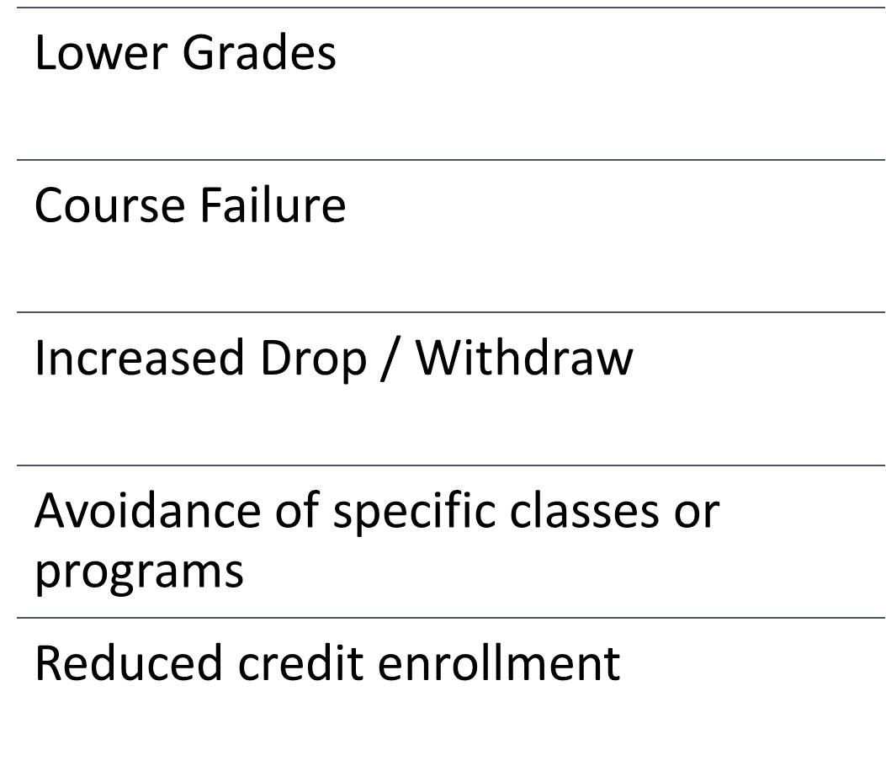
Effects of High-cost Instructional Materials
This Photo by Dids is licensed under CC BY
Notes:
Lower Grades
Failing Courses
Dropping / Withdraw from class
Avoid a class
Not purchase required materials
Delayed purchase
Took fewer credits

Slide 6
Barriers due to the cost of instructional materials
 | Spica & Biddix (2020) | Jenkins et al. (2020) | US PIRG (2020) | FLVC (2019) | Martin et al. (2017)
Poor grade | 16% | -- | -- | 36% | --
Failed a class | 3% | 9% | 3% | 17% | 4%
Dropped or withdrew | 10% | 12% | 7% | 23% | --
Avoided a class | 14% | 27% | 19% | 41% | 33%
Did not purchase | 41% | 65% | 65% | 64% | 66%
Delayed purchase | 69% | -- | -- | -- | 86%
Took fewer courses | 27% | -- | -- | 43% | 21%

Slide 7
Textbook Affordability Programs

Slide 8
What is (and isn’t) OER?

Slide 9
Open Educational Resources (OER) are teaching, learning, and research materials that are either (a) in the public domain or (b) licensed in a manner that provides everyone with free and perpetual permission to engage in the 5R activities.
-- Creative Commons
Notes:
© Copyright Showeet.com – Free PowerPoint Templates

Slide 10
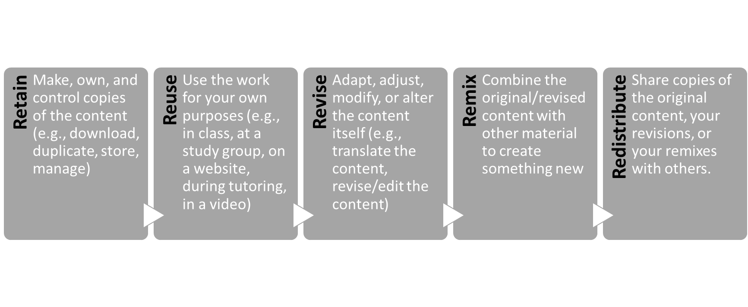
The 5 “Rs”

Slide 11
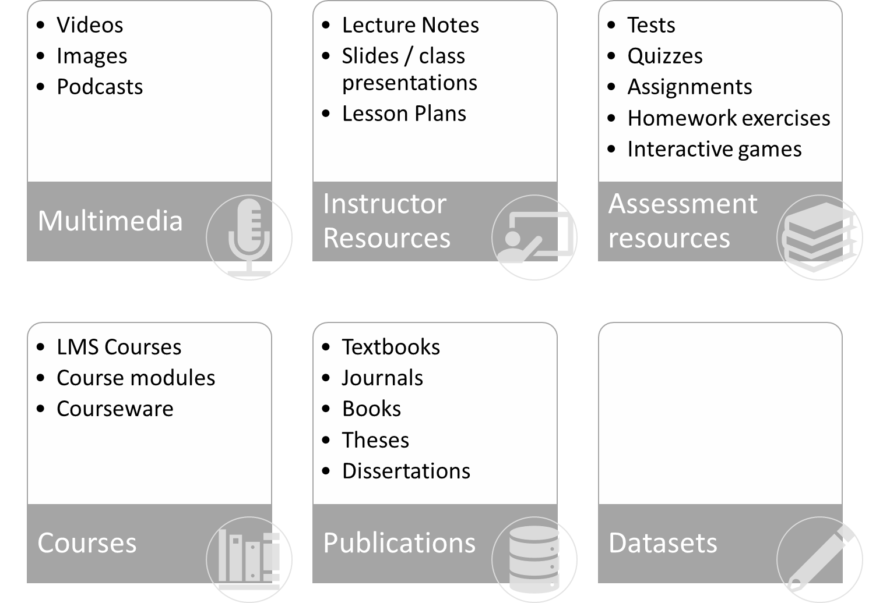
Types of OER
Notes:
Datasets include:
re3data.org Registry of research data repositories
ScholeXplorer Aggregation and query service for publications-data or data-data links from validated sources.
Harvard Dataverse Open source web application to share, preserve, cite, explore and analyze research data, developed at Harvard University.
Mendeley Data Open, free-to-use research data repository, which enables researchers to make their research data publicly available, hosted by Elsevier.
Figshare Open access repository where researchers can preserve and share their research outputs, including figures, datasets, images, and videos.
Dryad International repository of research data, especially data underlying scientific and medical publications.
Zenodo General-purpose open-access repository developed under the European OpenAIRE program and operated by CERN.
UCI Machine Learning Repository Collection of databases, domain theories, and data generators that are used by the machine learning community for the empirical analysis of machine learning algorithms, hosted by the UC Irvine.
OSF Free, open platform to support your research and enable collaboration.
Google Dataset Search

Slide 12
Why does OER matter?

Slide 13
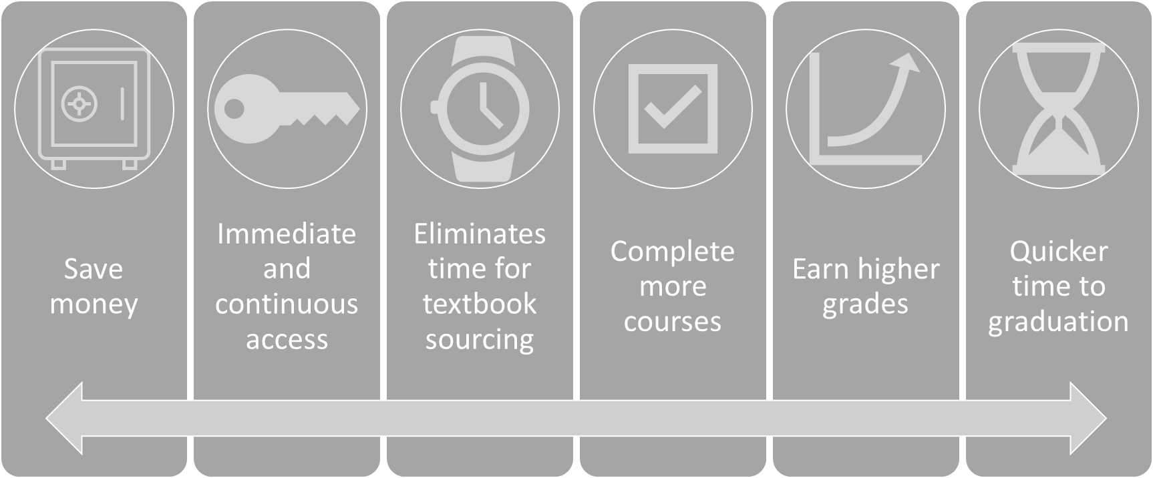
Value of OER to Students

Slide 14
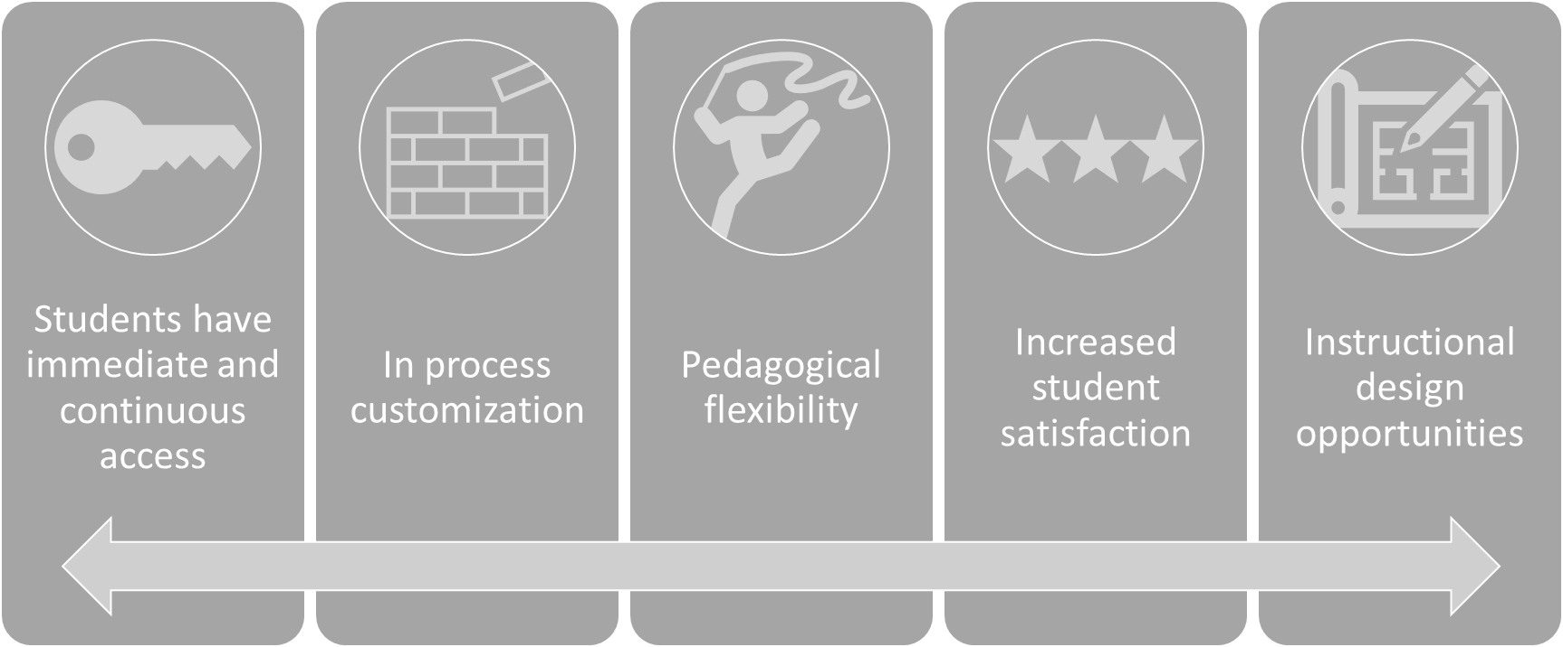
Value of OER to instructors

Slide 15
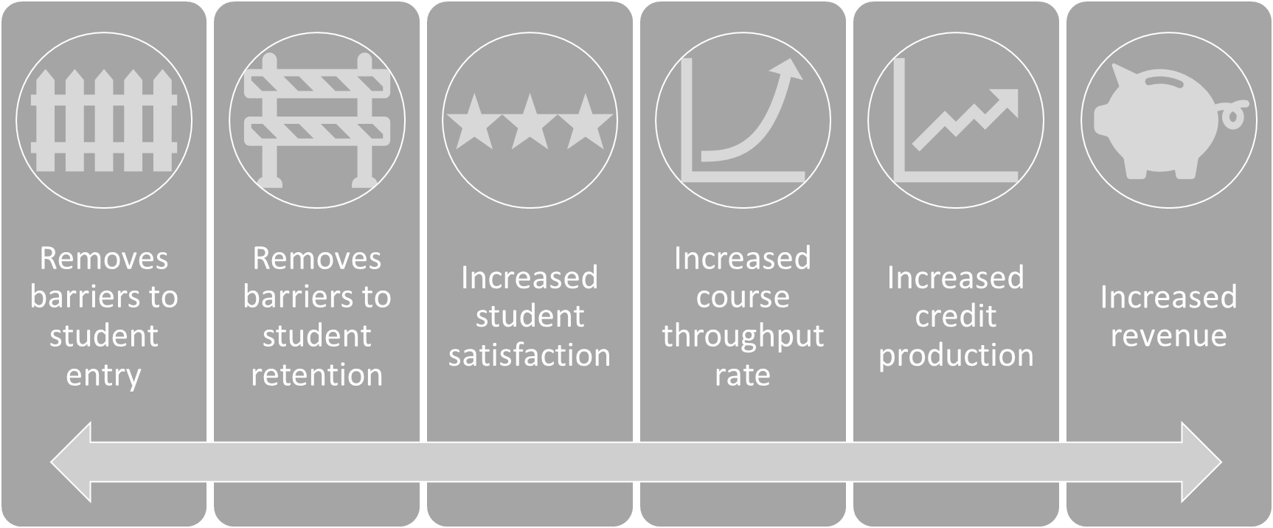
Value of OER to institutions

Slide 16
Notes:
In the next half hour or so we’ll talk about what content you can use, how you should give credit ot the creators of that content, and how you can mix together different content. Before we dive in, it’s important to understand the context that caused these licenses to come into existence.
Creative Commons was founded in 1999 by Stanford law professor Lawrence Lessig, seen here, and Eric Eldred, a computer programmer and literacy advocate who had made a career of making works available on the internet once their copyright expired and the works passed to the public domain. The organization, which is a global non-profit, was founded in reaction to The Copyright Term Extension Act of 1998. Basically what this Act did was extend copyright from the author’s life + 50 years to the author’s life +70 years.
Sometimes called the Mickey Mouse Copyright Extension Act because this was the year Steamboat Willie was due to enter the public domain.
Eldred tried to fight this extension all the way to the Supreme Court, arguing the Copyright Term Extension Act was unconstitutional, and while they lost that fight, they decided to go outside the box and create a set of licenses that protected creators’ rights while also allowing those works to be shared. They used Creative Commons to establish and facilitate the licenses we’re using today to build our free textbooks.
These licenses work within the confines of copyright law and give creators a way to maintain their rights without being restricted from sharing and letting others build upon their work.
SOURCES:
Background CCBY Licenses photo is licensed CC BY. Pixabay https://pixabay.com/vectors/creative-commons-licenses-icons-by-783531/
Larry Lessig giving #ccsummit2011 keynote”. DTKindler Photo. CC BY 2.0 Unported

Slide 17
The 6 CC Licenses
What content can we use?
How do we give credit?
How can we remix/adapt?
This Photo by Unknown Author is licensed under CC BY-SA-NC
This Photo by Unknown Author is licensed under CC BY-SA-NC
Notes:
These six licenses let creators make decisions about how what permissions they want to grant reusers, so long as they are attributed for their work. That’s what the BY symbol means – as you can see here giving credit to the creator is the basis of all the licenses.
The other three symbols help communicate what you can do with that content.
The NoDerivatives licenses in the middle and lower right prohibit reusers from sharing adaptations. For educators, this license is quite restrictive because we like to remix works to suit our specific purposes.
The third symbol means ShareAlike or “SA,” which means that any adaptations based on the work must be licensed under the same license of the original work.
The fourth and final symbol means NonCommercial or “NC,” which means the work is only available to be used for noncommercial purposes.
These are still copyright licenses, and if someone violates the terms of a CC license, it is copyright infringement no differently than copyright infringement for a traditionally copyrighted work.
As we look at how to ues these tools, we’ll focus on 3 Key Questions
What content can we use? Can we use copyrighted material? Spoiler alert on this, yes, it is possible to use traditionally copyrighted material.
How do we give credit?→ TASL
What can we remix/adapt/add our own content to? → Compatibility Chart & Adapter’s License Chart

Slide 18
Question 1 of 3
What content can we use?
Public domain material,
Openly-licensed/Creative Commons resources,
Your original (CC-licensed) work,
Copyrighted work you obtained permission to use,
Copyrighted work under Fair Use, and/or
Any combination of the above
Regardless which type you use, the best practice is to cite/attribute every source and list its appropriate license.
This Photo by Unknown Author is licensed under CC BY-SA
Notes:
Let’s get into it - what content can you use to create your open textbooks?

Slide 19
Q1 of 4. What content can we use? ✅ Public Domain Materials
This Photo by Unknown Author is licensed under CC BY-SA-NC
This Photo by Unknown Author is licensed under CC BY-SA-NC
Notes:
You’ll know public domain materials because of the age or because they bear one of these two public domain tools, which are also hosted by Creative Commons, the CC0 public domain tool and the Public Domain Mark.
You would use the CC0 tool on the top to dedicate your work to the worldwide public domain. You would use the Public Domain Mark on the bottom to label something and inform the public about the public domain status of someone else’s work. In general, all works published or released in the US before January 1, 1927 have entered the public domain. You’ll often see the Public Domain Mark used by museums and archives working with very old works.
Note that these public domain tools are not licenses, per se, but they do allow creators to dedicate their works to the public domain and, in the case of the Public Domain Mark, allow users to mark works known to be free of all copyright restrictions.
The public domain is the pool of creative materials from which new creativity and knowledge may be built. Works enter the public domain when
the copyright expires, which here in the US is the author’s life plus 70 years, thanks to the Copyright Term Extension Act.
The work was never entitled to copyright protection, like government works or certain works made for hire. Increasingly now grant-funding requires the final products to be released to the public.
3) The creator dedicates the work to the public domain before the term expires (using the CC0 tool on the top)
4) The copyright holder fails to comply with any formalities that might exist in their country to acquire or maintain their copyright. For most countries today there are no formal requirements, but there are cases where this happens and works fall into the public domain because the author did not take the proper steps.
Public domain works (not restricted by copyright) can be remixed with any work. For example: Anyone can remix the Adventures of Huckleberry Finn by Mark Twain with Alice’s Adventures in Wonderland by Lewis Carroll.
Federal government material/.gov website is usually considered OER. See Department of Interior Statement
ADDITIONAL RESOURCES
Information about public domain (Wikipedia CC-BY-SA 3.0)
Comic book about the public domain (Duke Law). https://web.law.duke.edu/cspd/comics/zoomcomic.html
Sites that host public domain works: Project Gutenberg, Public Domain Review, Digital Public Library of America, Wikimedia Commons, Internet Archive, Library of Congress, Flickr, and the Rijksmuseum. The CC Search tool is another way to find public domain material.

Slide 20
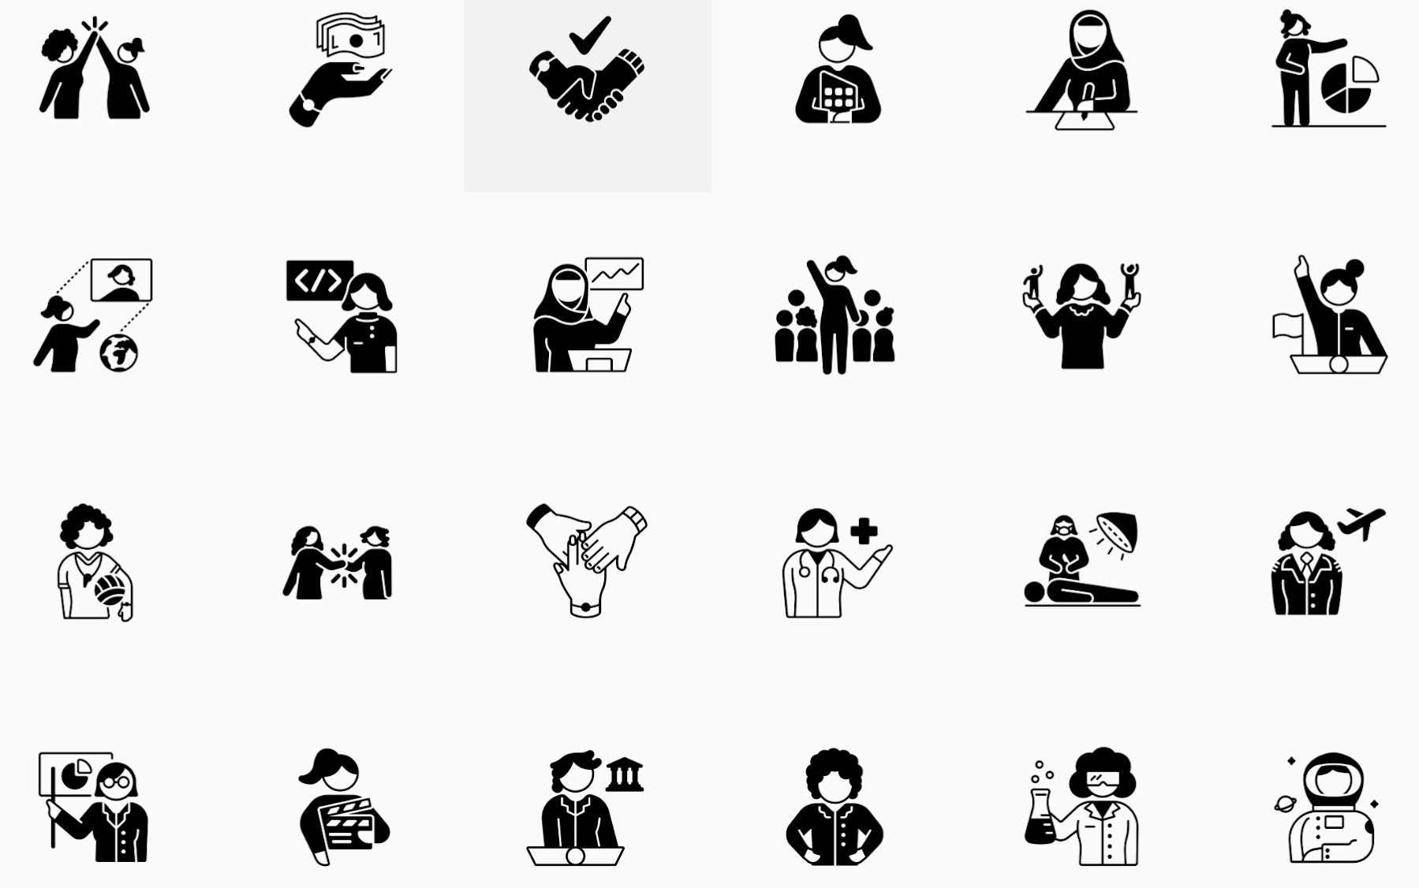
“Redefining Women” icon collection
thenounproject.com
Notes:
It’s not just old literary works that are in the public domain.
RESOURCES:
The Noun Project Public Domain images - “Redefining Women” Icon Collection

Slide 21
Question 1 of 3
What content can we use?
Public domain material,
Openly-licensed/Creative Commons resources,
Your original (CC-licensed) work,
Copyrighted work you obtained permission to use,
Copyrighted work under Fair Use, and/or
Cite/attribute every source.
This Photo by Unknown Author is licensed under CC BY-SA
Notes:
Now let’s look at Creative Commons-licensed material. Rachel is going to show you many places to find material; I’m going to share a few tools to help you understand how you should attribute your sources and how you can decide whether sources can be mixed and matched based on their license.

Slide 22
The Open Education Community recommends CC-BY for all educational materials.
Notes:
CC-BY is the standard. CC-BY licensed material can be mixed with any other license except ND No Derivative. It’s easy to use; no permission needed; just give credit to the author.
ADDITIONAL RESOURCES:
Open Textbook Community Advocates CC BY License for Open Textbooks. In 2016 members of the open Textbook community signed a joint statement advocating CC BY license for educational resources: https://open.bccampus.ca/2016/11/04/open-textbook-community-advocates-cc-by-license-for-open-textbooks/
“Why CC BY?” from Open Access Scholarly Publishers Association also advocates using CC-BY for publishing scientific research . : https://oaspa.org/why-cc-by/

Slide 23
Non-Commercial = “not primarily intended for or directed towards commercial advantage or monetary compensation.”
This Photo by Unknown Author is licensed under CC BY
Notes:
The “Non Commercial” CC-BY-NC license often causes confusion. Boy I don’t like this license, and you should try to avoid it wherever possible.
A noncommercial purpose is defined as one that is “not primarily intended for or directed towards commercial advantage or monetary compensation.” A lot of people want to use this license because don’t want companies exploiting their material for commercial purposes. That’s understandable, but licensing your work with this license causes problems for users downstream.
—
More info: Take this lawsuit for instance, where an NC license has been used to claim that OER cannot be printed by a commercial print shop for use in classrooms. Some Colleges have assumed that because they charge tuition, they can’t use NC-licensed OER. Others worry about printing and selling (cost recovery only) NC-licensed open textbooks.
This provides flexibility depending on the reuse situation, AND you’ll note the definition depends on the use, not the user.
For example, if you are a nonprofit or charitable organization, your use of an NC-licensed work could still run afoul of the NC restriction, and
if you are a for-profit entity, your use of an NC-licensed work does not necessarily mean you have violated the term. For example, a nonprofit entity cannot sell another’s NC licensed work for a profit, and a for-profit may use an NC licensed work for non-commercial purposes.
Whether a use is commercial depends on the specifics of the situation.
ATTRIBUTION:
The content on this slide was adapted from the June 2020 Creative Commons Certificate Course by Creative Commons, licensed CC BY 4.0. Access the full contents at https://certificates.creativecommons.org/cccertedu/.

Slide 24
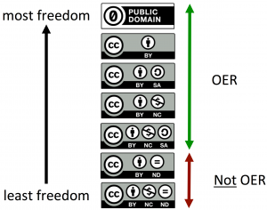
“No Derivative” ND Content
Sure, you can use it. You just can’t change ANYTHING.
Notes:
ND licenses do not meet the 5Rs requirements that Ryan talked about, nor do they allow the public to revise or remix the resources… because they don’t meet the major OER definitions, the open education community does not consider ND-licensed education resources “OER.”
But you CAN use them without asking permission from the author, so that makes them good. You just can’t change them at all when you use them, which is sad.

Slide 25
Question 1 of 3
What content can we use?
Public domain material,
Openly-licensed/Creative Commons resources,
Your original (CC-licensed) work,
Copyrighted work you obtained permission to use,
Copyrighted work under Fair Use, and/or
Any combination of the above
Cite/attribute every source.
This Photo by Unknown Author is licensed under CC BY-SA
Notes:
So we’ve talked about basics, but before I show you how to attribute and remix the openly-licensed content you find, I want to make a nod copyrighted material. Of course, if you can find all OER, that’s ideal. But can you use copyrighted material too?? Yes. You can even use traditionally copyrighted material when you either 1) have permission in writing; 2) you use the content under Fair Use, or 3) in absence of 1 & 2, you link to it instead of copying it right into your manuscript.

Slide 26
Fair Use?
Is your use transformative?
Think of the research paper…
Courts consider…
the purpose and character of your use,
the nature of the copyrighted work,
the amount and substantiality of the portion taken, and
the effect of the use upon the potential market.
When in doubt, find other material, seek permission, or link.
Notes:
Whether or not your use of copyrighted work is proper under Fair Use ultimately hinges on whether the use is transformative, or whether the use employs the quoted matter in a different manner or for a different purpose form the original. In other words, does your use transform that content into a different state or thing?
The easiest analogy is the research paper. You have a different point you’re making and you’re using sources to make that point. That’s transformative. We use Fair Use all the time as academics for scholarship and research, even though we don’t think about it as such.
So yes, you can use copyrighted material so long as it’s a Fair Use. When in doubt,
—-
17 USC 107. Limitations on Exclusive Rights: Fair Use
for purposes such as criticism, comment, news reporting, teaching (including multiple copies for classroom use), scholarship, or research, is not an infringement of copyright. In determining whether the use made of a work in any particular case is a fair use the factors to be considered shall include—
the purpose and character of the use,--> is it of a commercial nature? or is for nonprofit educational purposes also look at the transformative nature;
the nature of the copyrighted work;
the amount and substantiality of the portion used in relation to the copyrighted work as a whole → the less transformative, the more justification you need, and
the effect of the use upon the potential market for or value of the copyrighted work → MOST IMPORTANT considers extent of [replacement] harm caused by particular infringer actions and whether unrestricted and widespread conduct of the sort engaged by infringer would result in substantially adverse impact on the potential market for the original)
Cases:
American Geophysical Union v. Texaco where researchers photocopying articles from journals within Texaco library was held not to be fair use
Blanch v. Koons where Koon’s incorporation of Blanch’s photograph of womans legs within commentary-based painting was fair use
Authors Guild v. Google, Inc. where Google’s scanning of all of or portions of the major book collections in the world with the goal of making those texts searchable is not infringing on those books under fair use

Slide 27
When in doubt, link.
Try your best to select CC-licensed or public domain videos in the first place.
Embed videos from video-sharing websites for which:
the Terms of Service clearly indicate this action is permitted
copyright holders can remove their videos in cases of copyright infringement
Provide proper attribution
This Photo by Unknown Author is licensed under CC BY
Notes:
Linking to a website or deep linking to a web page does not require permission from the copyright holder and is not considered copyright infringement. Like for instance Amanda Gorman's poem, "The Hill We Climb," the text of which is readily available from multiple sources all over the internet.
However, linking to a website that obviously violates copyright law, such as one that hosts pirated music or films, should be avoided.
RESOURCES:
https://opentextbc.ca/selfpublishguide/chapter/embed-and-link/
Self-Publishing Guide by BCcampus is licensed under a Creative Commons Attribution 4.0 International License, except where otherwise noted.

Slide 28
Question 2 of 3:
How do we give credit?
TASL Method & CC License Tool
Notes:
Let’s move on to question two - talk about how to give proper credit to authors for any work you use.

Slide 29
License v. Attribution v. Citation
License. What you give to works you create to communicate the permissions you grant for that work’s reuse.
Attribution. The credit you give to authors of openly-licensed works.
Citation. The credit you give to authors of traditionally copyrighted works.

Slide 30
Licensing & Attribution
TASL
T = Title
A = Author (To whom should credit be given?)
S = Source (Where can people find the resource? Provide a link.)
L = License (Link to the appropriate CC license deed)
Title - Author - Source - License
Notes:
Whether you are licensing individual elements of your original work that you’ve created for your textbook (for instance, if you write an introduction to a unit, or if you write a series of assessment questions),
Or whether you are attributing the authors whose openly-licensed work you are using in your textbook, the best practice is to follow the TASL formula – TITLE, AUTHOR, SOURCE, and LICENSE, and include links wherever possible.
T = Title
A = Author (tell reusers who to give credit to)
S = Source (give reusers a link to the resource)
L = License (link to the CC license deed)
Current best practice for an attribution statement states it should reside on the same page (digital or printed) as the resource it refers to. Statements can stand alone, e.g., within the caption of an image, or in a list at the bottom of the page.

Slide 31
Licensing Your Textbook
Title, Author, Source, License
Except where otherwise indicated, this work (Course Textbook/Title & Link Here, by Betty Abrams, Harold Watson, and Kathy Green) is licensed under a Creative Commons Attribution 4.0 International License.
OR, this shortened version:
Except where otherwise noted, “This Very Awesome Textbook” by Betty Abrams, Harold Watson, and Kathy Green is licensed CC-BY 4.0.
Notes:
Let’s start at the top level.
As per the requirements of the grant, your entire project should include a blanket licensing statement patterned after this one.
Why “Except where otherwise indicated”? Because inevitably you’ll have a mix of licenses and probably some copyrighted material used under Fair Use as well.
“Except where otherwise indicated, this work (Insert Title of Work Here, by Bugs Bunny, Daffy Duck, and Sylvester Cat) is licensed under a Creative Commons Attribution 4.0 International License.”
ATTRIBUTIONS
Images on this page are from from wiki.creativecommons.org https://wiki.creativecommons.org/wiki/Marking_your_work_with_a_CC_license

Slide 32
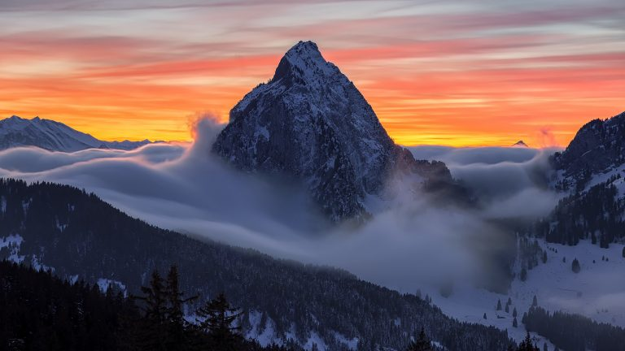
Attributing Individual Elements: Image Example Title, Author, Source, License
“Furggelen afterglow” by Lukas Schlagenhauf is licensed under CC BY-ND 2.0.
Notes:
ATTRIBUTIONS
Images on this page are from from wiki.creativecommons.org https://wiki.creativecommons.org/wiki/Marking_your_work_with_a_CC_license

Slide 33
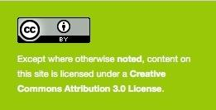
Attributing Individual Elements Title, Author, Source, License
Image: Office calculator image (https://pixabay.com/en/office-pen-calculator-computation-1574717/) by The Digital Way and provided by Pixabay is licensed under CC0: No Rights Reserved
Image: Unnamed Photo by John Price is licensed under CC0
Notes:
The best practice is to place the attributions as close to the content as possible. For some images, it might be right below the image. For most things, you’ll want to footnote and use the footer area for your attributions.
ATTRIBUTIONS
Images on this page are from from wiki.creativecommons.org https://wiki.creativecommons.org/wiki/Marking_your_work_with_a_CC_license

Slide 34
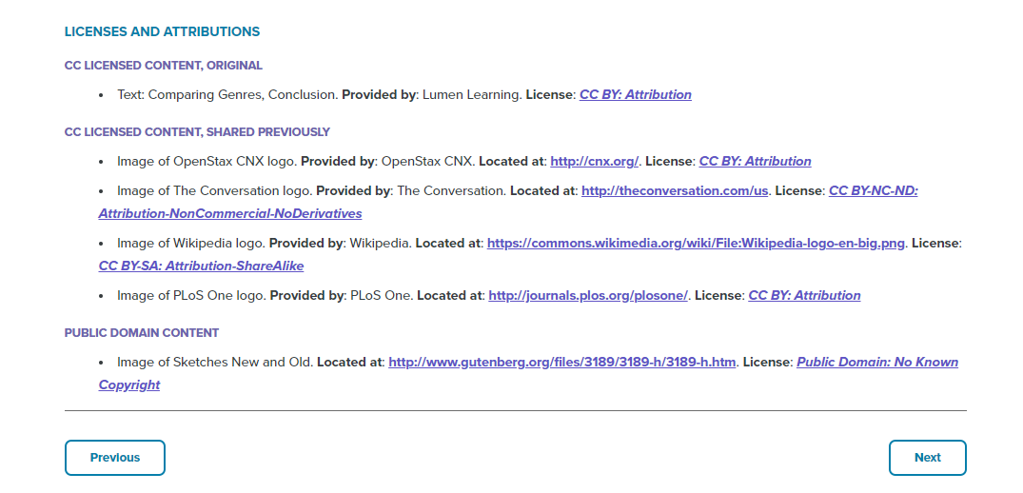
Screenshot from Characteristics of Genres by Lumen Learning is licensed CC-BY 4.0.
Notes:
There is some flexibility so don’t worry about the details. For example, here’s an example taken from Lumen Learning’s English Composition course.
Source: https://courses.lumenlearning.com/englishcomp1/chapter/text-comparing-genres-conclusion/

Slide 35
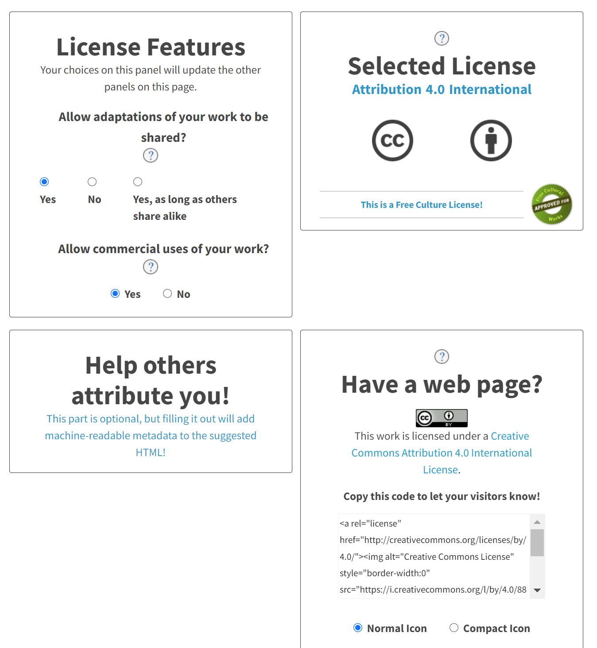
Tool #1:
The CC License Chooser & Attribution Tool https://creativecommons.org/choose/
Notes:
Creative Commons has made this process very easy by creating a License Chooser that lets you enter your information, then it generates a code and a copy/paste that you can drop onto your work, website, or elsewhere.
1. Copy and paste the HTML code into your webpage or website.
2. Edit the descriptive text to suit your needs.
ADDITIONAL RESOURCES:
The CC License Chooser - https://creativecommons.org/choose/
The CC License Chooser beta (new version being tested): https://chooser-beta.creativecommons.org/
The CC Zero License Waiver tool (generate license for your CC0 materials): https://creativecommons.org/choose/zero/waiver

Slide 36
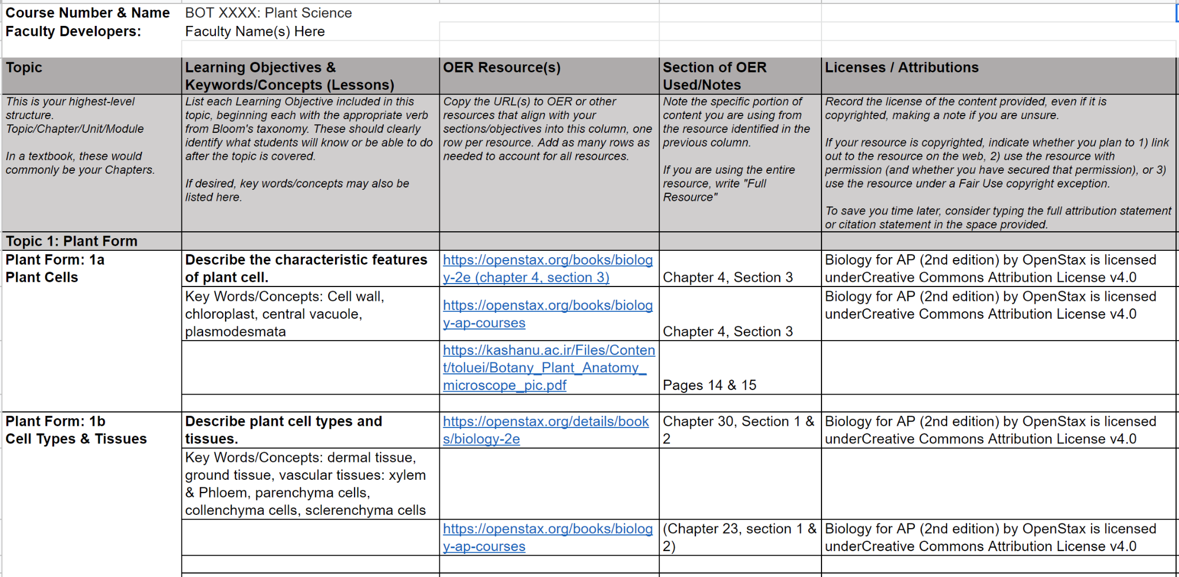
Keeping it all Straight: The Course Map
Notes:
Why use the course map?
Helps you organize your material,
Keeps you out of the weeds and helps you determine when you have enough for a particular section.
Provides a concise map that can be shared with other instructors.
Helps identify and mark areas for future development.
Serves as a record of what has been officially included in your course. If the paper trail comes back to you, this is what you should present.

Slide 37
Question 3 of 3
What can we remix/adapt?
Adapt compatible licenses to create the perfect solution.
Notes:
One of the beauties of OER is that, with certain licenses, you can mix and match the materials to create the perfect solution for your course.
Question 3 tackles the all-important situation that you will come across. You’ll inevitably find multiple CC-licensed sources that you want to blend together. Or, you’ll find a Cc-licensed source that you want to augment with your own material. This is what we call a remix or adaptation, or even derivative – they all mean the same thing.

Slide 38
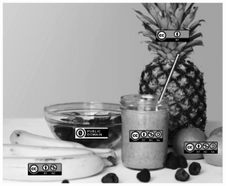
The Remix “Smoothie”
Remixes/adaptations happen when you cannot tell where one open work ends and another one begins.
When remixing, take care to only mix content with licenses that allow remixing.
Notes:
When you start creating your textbook, you’re probably going to mix content together in such a way that you don’t know where one part stops and another starts. This is called a remix or adaptation.
Adaptations happen when you truly remix OER material and create a work with some new creativity. For example, I’m putting together a Trademark textbook and, in working on the intro chapter I’ve found three CC-licensed works that each have something of value. I’m going to blend them together to make a perfect chapter, and the reader won’t be able to tell where one resource stops and another starts. This is an adaptation, or a Smoothie where you can’t tell where the pineapple stops and the banana or orange begins.
IMAGE ATTRIBUTION:
“CC TV Dinner” by Nate Angell. CC BY. Derivative of “tv dinner 1″ by adrigu (https://flic.kr/p/6AMLDF) used under CC BY, and various Creative Commons license buttons by Creative Commons (https://creativecommons.org/about/downloads) used under CC BY.
IMAGE ATTRIBUTION: “CC Smoothie” by Nate Angell. CC BY. Derivative of “Strawberry Smoothie On Glass Jar” by Element5 (https://www.pexels.com/photo/strawberry-smoothie-on-glass-jar-775032/) in the public domain, and various Creative Commons license buttons by Creative Commons (https://creativecommons.org/about/downloads) used under CC BY.

Slide 39
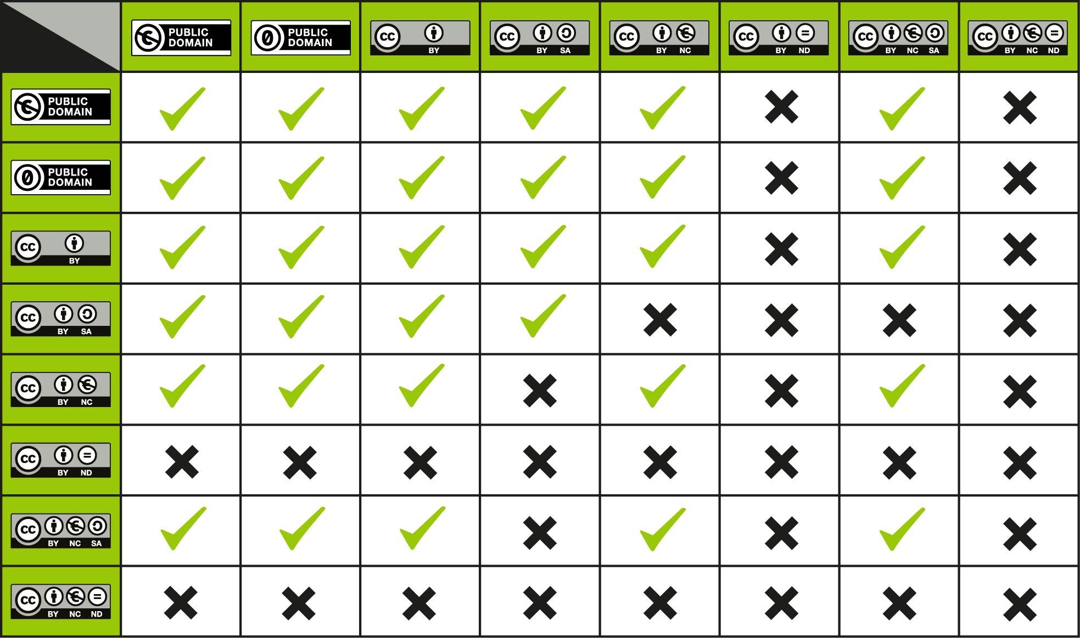
Tool #2: The CC License Compatibility Chart
CC License Compatibility Chart / CC BY 4.0
Notes:
This great tool from Creative Commons – CC License Compatibility chart – helps you see what material can be remixed.
To use the chart, find a license on the left column and on the top right row. If there is a check mark in the box where that row and column intersect, then the works can be remixed. If there is an “X” in the box, then the works may not be remixed unless an exception or limitation applies.
Example: You find a great section for your chapter on trademark, but you want to change it and insert some examples. You write all of the examples and license it CC-BY. You add that paragraph to the beginning of the CC-BY-ND
Example: Wikipedia (BY-SA) allows you to reuse their content for commercial purposes, while WikiHow (BY-NC-SA) does not. A Wikipedia article cannot be remixed with a WikiHow article.
Example: Look at all that can be mixed!
IMAGE ATTRIBUTIONS
CC License Compatibility Chart by Creative Commons is licensed under a CC BY 4.0 license. https://creativecommons.org/licenses/by/4.0/

Slide 40
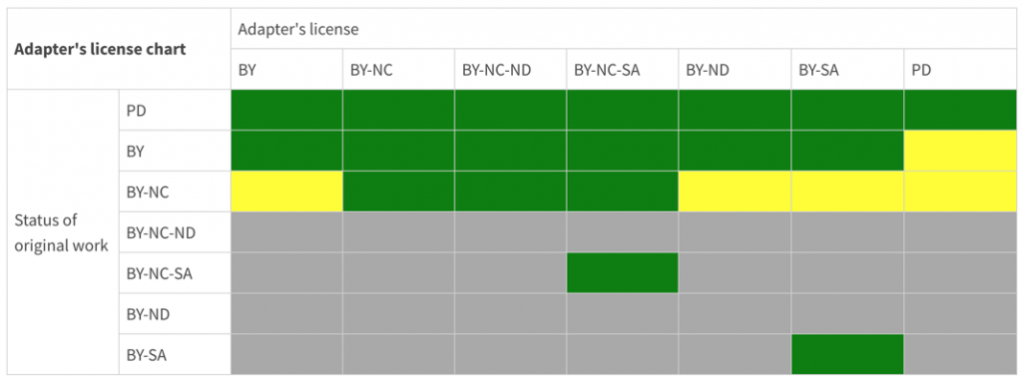
Tool #3: The Creative Commons Adapter’s License Chart
Use this to determine which license you should apply to your remix.
The CC Adapters License Chart is licensed under CC BY 4.0.
Notes:
So remember how earlier we were talking about how some of the licenses don’t play well when it comes to mixing and matching? This brings us to our third and final tool, the Adapter’s License Chart. You will use this chart to decide (1) Whether you can mix material and (2) which license to apply to the remix. This is less relevant for your purposes, because you are licensing one textbook “unless otherwise indicated” and then attributing/citing sources throughout that one work.
However, in the event that you do standalone works that combine different CC-licensed material, you’ll need to know which license to apply to that remix, and that’s where this tool comes in handy.
The basic rule is – whatever the most restrictive license of the material you’re mixing – you have to apply that license to the adaptation.
The left-hand side shows the licenses of the original works you’ve adapted – remember that their individual copyrights will still govern the reuse of that material in your adaptation. The top are the options for licensing your remix. Green are possibilities; yellow are technically permitted but not advised(and if you go yellow, make sure you note that there are multiple copyrights and users are responsible for complying with all licenses for any of their uses down the line). Gray boxes indicates incompatible licenses.
Here’s a common scenario with the trademark textbook I’m working on. There’s already material out there for the first chapter, “What is trademark?” I’ve written an introduction, licensed CC-BY, and then found three sources that are CC-BY and one Public Domain source. I’ve mixed and molded all of these together and now I want to publish it as a standalone PDF. This scenario is easy - I can license this as any of the green in the second row.
2. But let’s say that ONE of those three resources I found on Wikipedia, which is CC-BY-SA. This limits me. This means the chapter must be licensed CC-BY-SA.
3. But let’s say one of those three sources that I absolutely had to have was BY-NC. This means I cannot license my remix CC-BY. I have to pick one of the three NC licenses.
4. If one was CC BY-NC and one was CC-BY-SA, I have some tough decisions to make because the SA and NC materials don’t play together. Does that make sense?
This may be relevant if you’re creating things outside of your textbook, like an instructor’s manual, or a worksheet… anything outside the blanket license of your textbook that mixes different CC-licenses will need to be licensed accordingly.
Example: You find a great worksheet, but you want to change the instructions or write an intro paragraph to make the assignment better. You write all of that and license it CC-BY. You add that paragraph to the beginning of the CC-BY-ND worksheet… how do you then license that new thing?
And who can help with that? Your campus librarian is the best resource for properly citing and attributing sources. Consult with them when you have questions.

Slide 41
Recap
Course Map keeps you organized. You’ll thank yourself later.
CC License Chooser creates attributions for you.
CC Compatibility Chart tells you what you can remix.
Adapter’s License Chart helps you apply the right license to your remix.
Fair Use considerations for copyrighted materials
Find links in your Guide.
You’ve got this! 🏆
Notes:
And speaking of librarians, before I pass it on to Rachel Fleming, let me quickly recap our three questions and the resources available to you in the Guide that accompanies this presentation:
What content can we use?
Course Map - Organizing content and relevant licenses
How do we give credit?
CC-License Chooser. Apply a CC license to your work or enter information to generate attribution for the works of others. Consider also trying the new beta chooser.
What can we remix/adapt/add our own content to existing CC resources?
CC Compatibility Chart. Determine which works can be remixed.
Adapter’s License Chart. Helps you decide which license to apply to your remix based on the licenses of the works you’ve included.
Can we use copyrighted material?
Okay, now that you understand a little better what these licenses are about and how to work with them, I’ll pass it over to Rachel Fleming, OER expert and Scholarly Communications librarian at the University of Tennessee Chattanooga, to cover finding and evaluating resources.

Slide 42
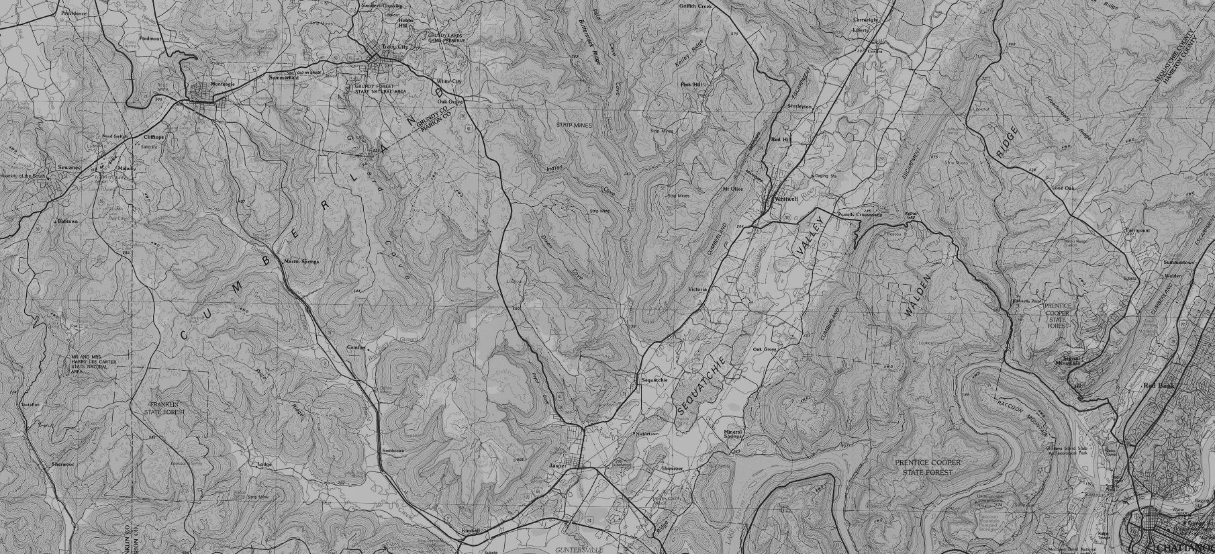
Course Design Resources
Quality Matters
Universal Design for Learning
Backwards Design
Course Mapping
High-Impact Practices
Consult your campus Center for Teaching and Learning or explore the links in the Resource Guide

Slide 43
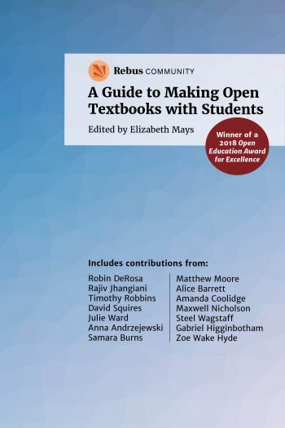
“So one key component of Open Pedagogy might be that it sees access, broadly writ, as fundamental to learning and to teaching, and agency as an important way of broadening that access.
To summarize, we might think about Open Pedagogy as an access-oriented commitment to learner-driven education AND as a process of designing architectures and using tools for learning that enable students to shape the public knowledge commons of which they are a part. We might insist on the centrality of the 5 Rs to this work, and we might foreground the investments that Open Pedagogy shares with other learner-centered approaches to education. We might reconstitute Open Pedagogy continually, as our contexts shift and change and demand new, site-specific articulations.”
DeRosa and Jhangiani, Open Pedagogy, https://press.rebus.community/makingopentextbookswithstudents/chapter/open-pedagogy/

Slide 44
Open Pedagogy Examples

Slide 45
Adopt. Adapt. Create.
Notes:
The other best practice I can share is that wherever possible you should ADOPT existing materials. People have done this work. Don’t reinvent the wheel. Promote and improve upon the work of others, and create your own only where absolutely necessary.

Slide 46
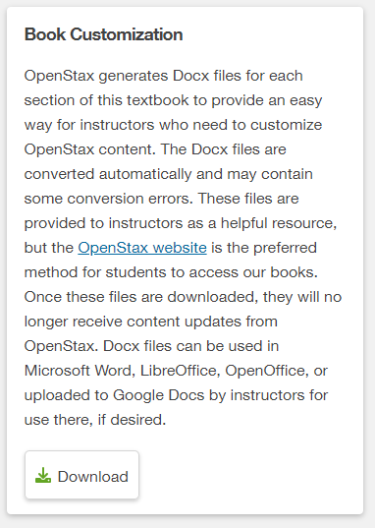
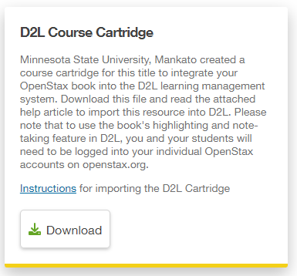
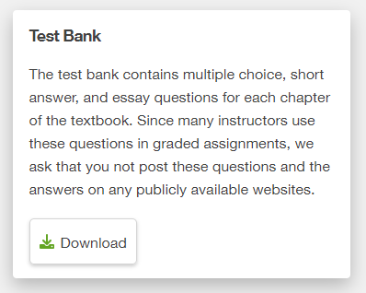

Slide 47
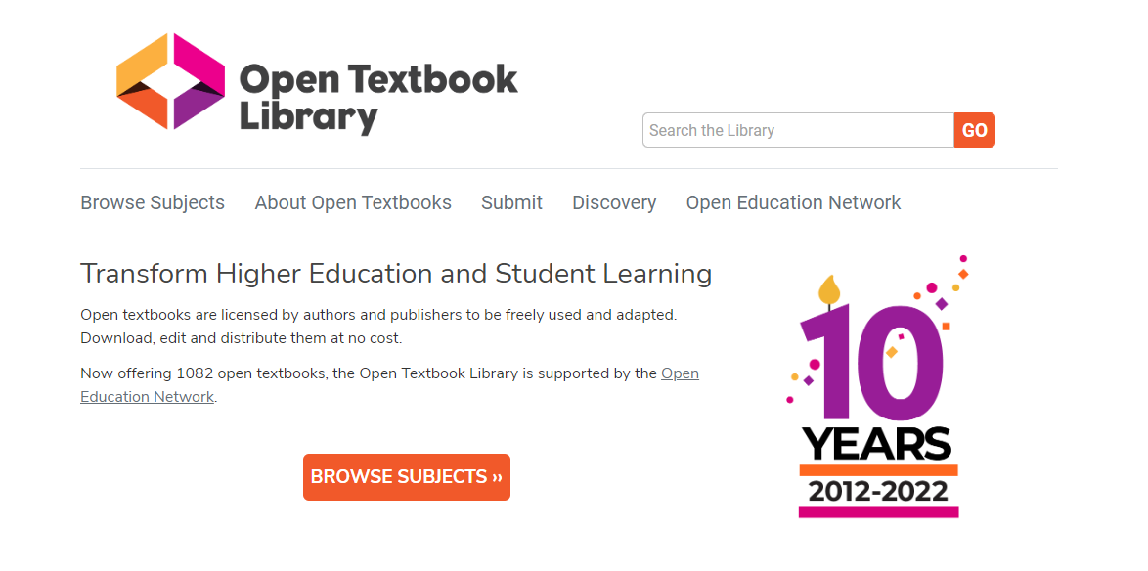

Slide 48
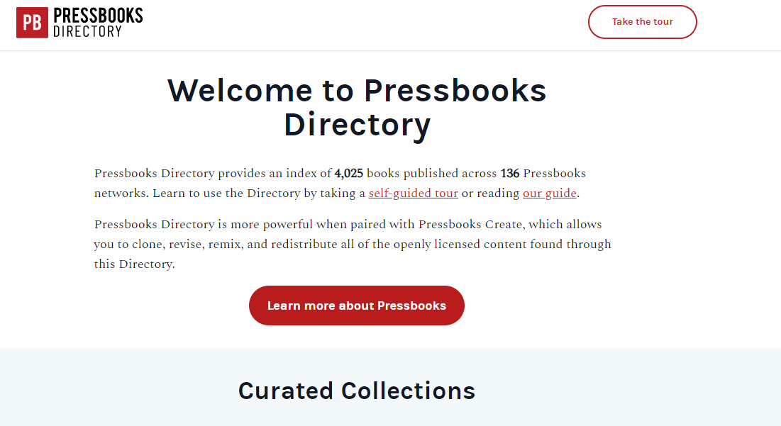

Slide 49
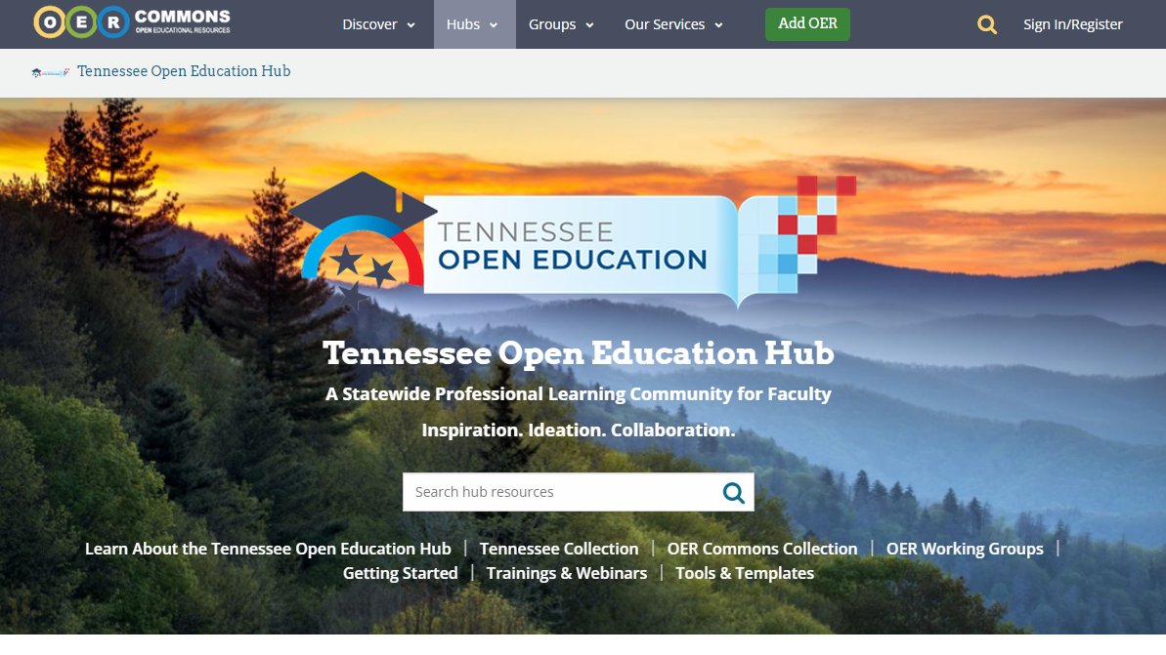

Slide 50
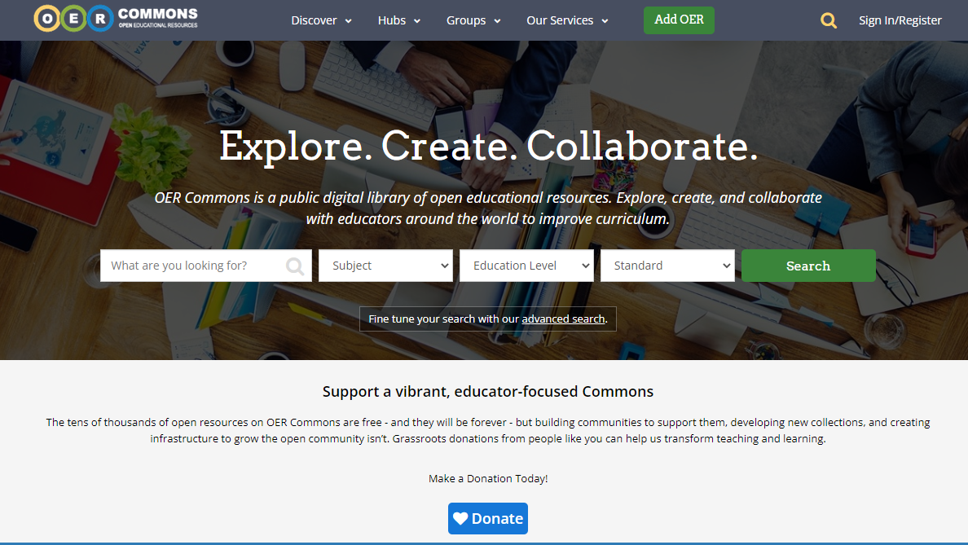

Slide 51
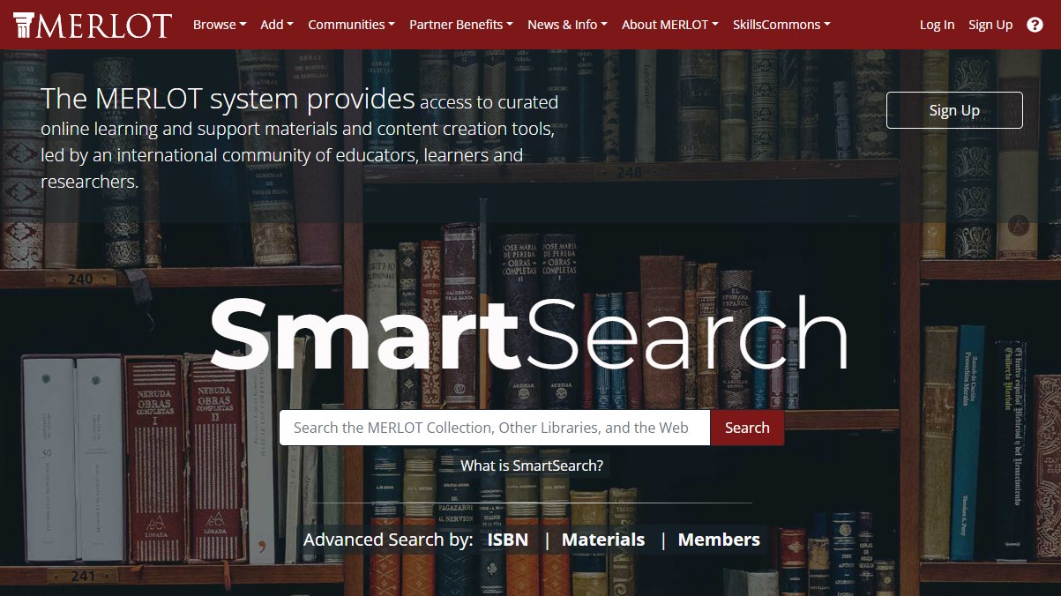

Slide 52
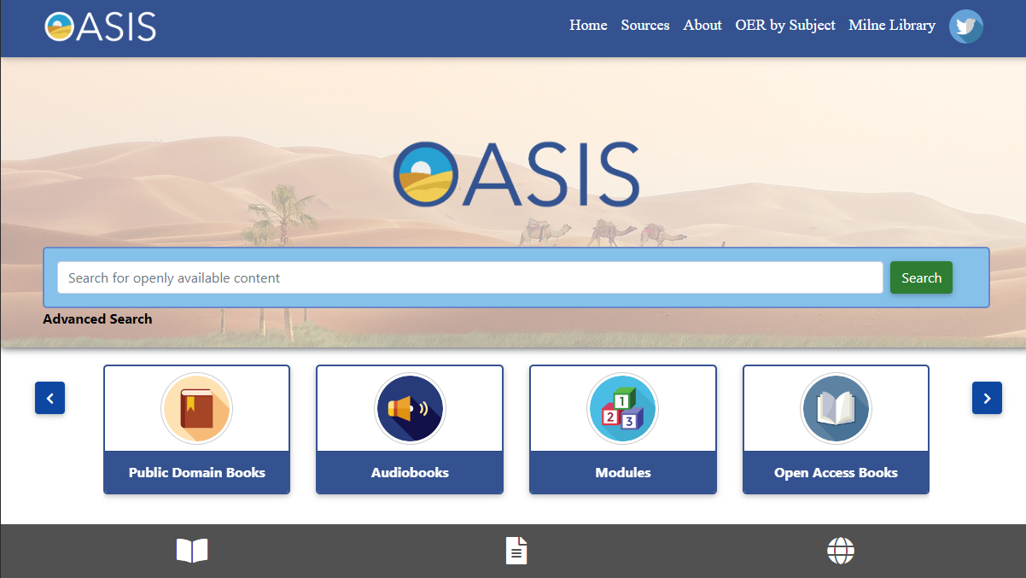

Slide 53
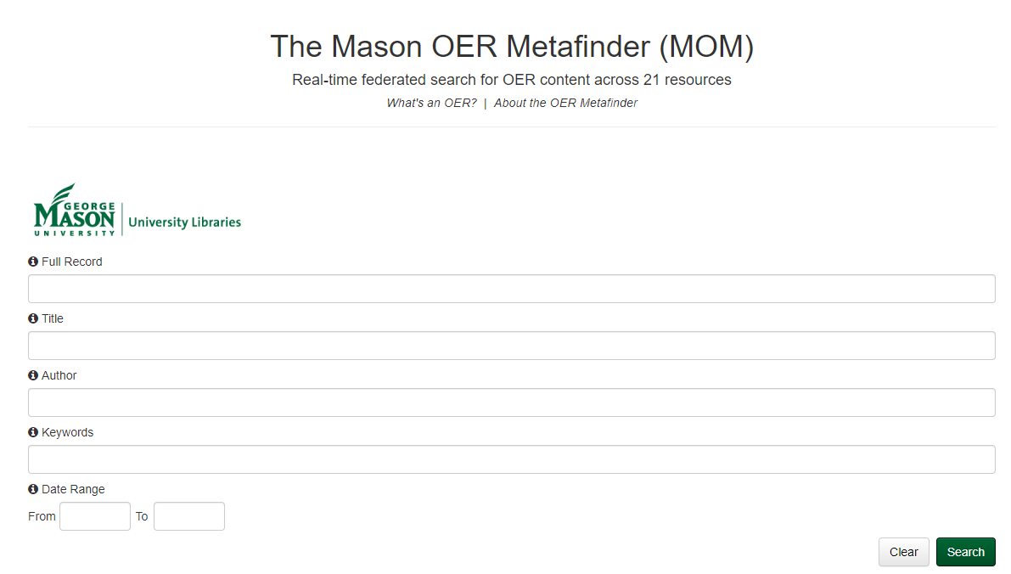

Slide 54
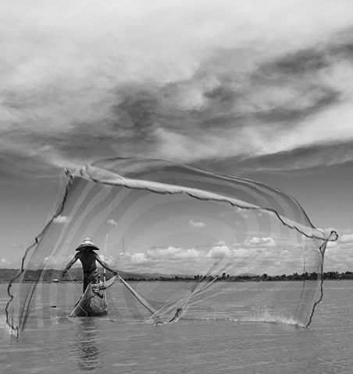
Searching Tips: cast a wide net
broad terms
many searches on many sites
use limiters
Stuck? Ask your Colleagues!
CCC-OER Listserv
Tennessee Textbook Affordability ListServ
Hendrik Saleh, Bahasa Indonesia: Aktifitas nelayan di danau Limboto CC-BY-SA

Slide 55
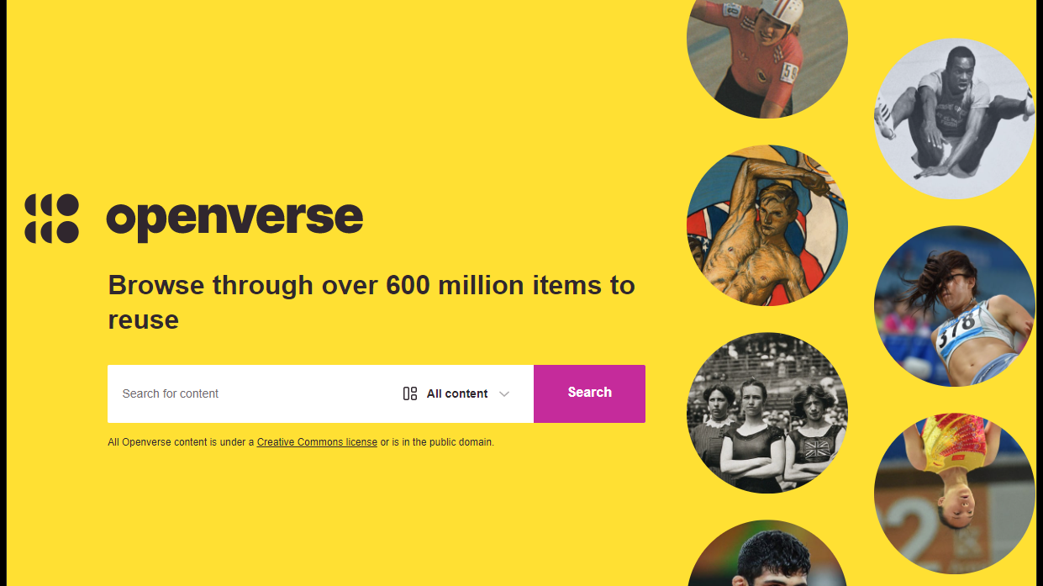

Slide 56
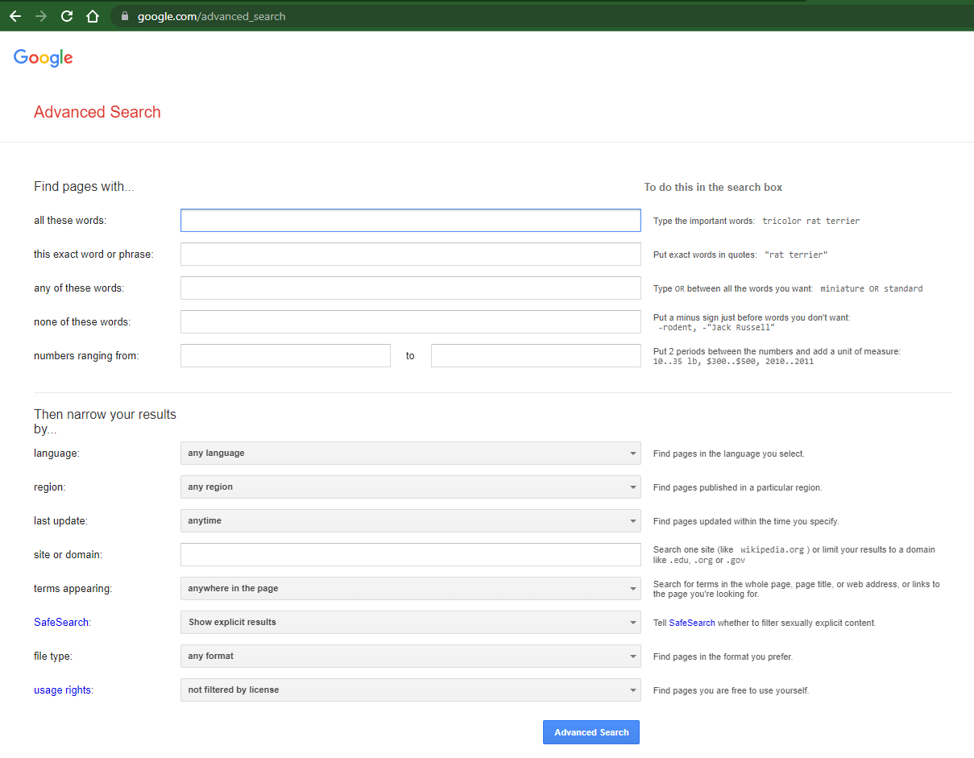
Google Advanced Search
G

Slide 57
Filter by Usage Rights in Google Image Search

Slide 58
Evaluating Course Materials
That the content under consideration covers the subject area appropriately
That the content of the OER is accurate and free of major errors and spelling mistakes
That the license of the content can be used or altered for the course's needs
That the OER is clearly written and appropriate for the students' level of understanding
That the accessibility of the content is appropriate for all students
Open Textbook Library Open Textbooks Review Criteria
BC Campus Faculty Guide for Evaluating Open Education Resources
Abbey Elder https://instr.iastate.libguides.com/oer/evaluate

Slide 59
5 Principles Adapted from Dr. Eric Moore, The University of Tennessee
Use built-in formatting and stylistic tools (rather than manual).
Make visual content usable non-visually
Build content with visibility in mind.
Use accessibility checking tools.
Convert to HTML or PDF from Word/PowerPoint with the right tools
This Photo by Unknown Author is licensed under CC BY
Notes:
For word, this means Built-in “heading” styles b. Built-in list featuresc. Built-in columns and breaks.
For PPT, it means using layout templates . a. Images Alt text b. Tables & graphs c. Descriptive links
Ensure that font size is sufficiently large—generally a minimum of 11 points.b. Provide sufficient contrast between text colors and background colors.c. Do not use color as the ONLY way to convey content.
Use contemporary accessibility checking tools available in many modern software applications including all of the Microsoft Office 2016 applications and Canvas.
Exporting documents to PDF through the proper channel can transfer accessibility efforts from PowerPoint to PDF without further work!

Slide 60
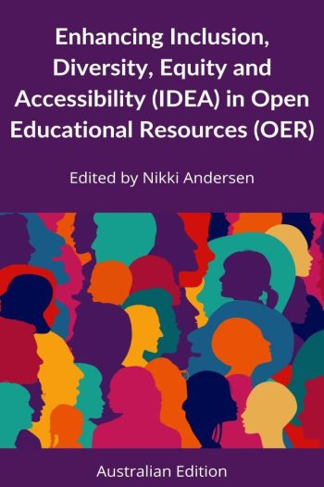
How is your team infusing diversity, relevant and current examples, and/or local cultures into your project?
Supplement existing content with current, relevant, local examples
Opportunities to infuse diversity throughout with “Feature Boxes” & more
Assessments, Quiz Banks, Tests, etc.
https://usq.pressbooks.pub/diversityandinclusionforoer/
An adaptation and expansion of OpenStax’ Improving Representation and Diversity in OER Materials

Slide 61
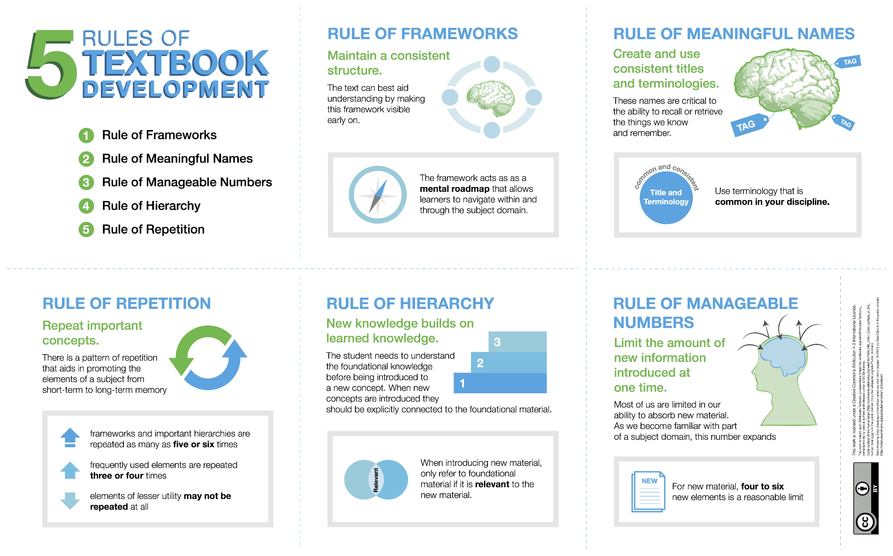
Self-Publishing Guide by BCcampus is licensed under a Creative Commons Attribution 4.0 International License, except where otherwise noted.
Notes:
The Self-Publishing Guide by BCcampus provides 5 rules for developing textbooks.
1. Rule of frameworks. Using a consistent framework will help students internalize and make use of material. For us, this
2. Rule of meaningful names. Everything we know is tagged with an index or a title. These indices are critical to the ability to recall or retrieve the things we know and remember. Each concept, process, technique or fact presented should aid the student to assign a meaningful name for it in their own mental organization of the material. To be most useful, these names shouldn’t have to be relearned at higher levels of study. The names assigned by the text should be useful in that they support some future activities: communication with other practitioners, reference within the text to earlier mastered material, and conformity to the framework used for the subject. Each unique element of the subject domain should have a unique name, and each name should be used for only one element.
3. Rule of manageable numbers.
When we learn from an outline, an illustration, or an example, most of us are limited in our ability to absorb new material. As we become familiar with part of a subject domain this number expands, but for new material four to six new elements is a reasonable limit. If a chapter outline contains twelve items, the student will have forgotten the outline before getting to the last item. When a text fails to support this rule, it requires even a diligent student to needlessly repeat material.
4. Rule of hierarchy
Our mental frameworks are hierarchical. Learning is aided by using the student’s ability to couple or link new material with that already mastered. When presenting new domains for hierarchical understanding, the rules for meaningful names and manageable numbers have increased importance and more limited application. A maximum of three levels of hierarchy should be presented at one time. The root should be already mastered, the current element under consideration clearly examined, and lower levels outlined only to the extent that they help the student understand the scope or importance of the current element. This area is supplemented by two more rules within this rule: those of Connectivity and Cohesion. Connectivity requires consideration of what the student likely knows at this point. The more already mastered elements that one can connect with a new element, the easier it is to retain. Cohesion requires that the characteristics of new elements as they are presented be tightly coupled.
5. Rule of repetition
Most people learn by repetition, and only a few with native genius can achieve mastery without it. There is a pattern of repetition that aids in promoting the elements of a subject from short-term to long-term memory. Implementations of this rule may mean that frameworks and important hierarchies are repeated as many as five or six times, while frequently used elements are repeated three or four times, and elements of lesser utility may not be repeated at all. The first repetition should normally occur within a day of first presentation, followed by a gradually decreasing frequency. Exercises and review sections are ideally contributing to a designed repetition pattern.

Slide 62
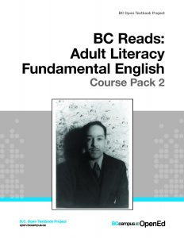
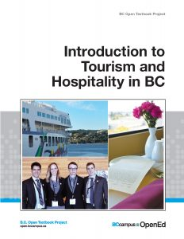
Final Touches: The Cover
Textbook title
Subtitle
Edition number and type (if relevant)
Author(s) or editor
Name of institution sponsor or funder
Attribution statement for cover art
Self-Publishing Guide by BCcampus is licensed under a Creative Commons Attribution 4.0 International License, except where otherwise noted.
Notes:
RESOURCES:
Covers: https://opentextbc.ca/selfpublishguide/chapter/textbook-cover/
Checklists https://opentextbc.ca/selfpublishguide/back-matter/appendix-5/
Self-Publishing Guide by BCcampus is licensed under a Creative Commons Attribution 4.0 International License, except where otherwise noted.
BCcampus Open Education website (screenshots) are used under a CC BY 4.0 International Licence.

Slide 63
Thank You!

Slide 64
Questions?

Slide 65
Reminders
TBR’s We All Rise Conference - October 19-20 in Murfreesboro, TN.
Join the TN Textbook Affordability Listserv
Join the TN Open Education Hub

